Slide 1
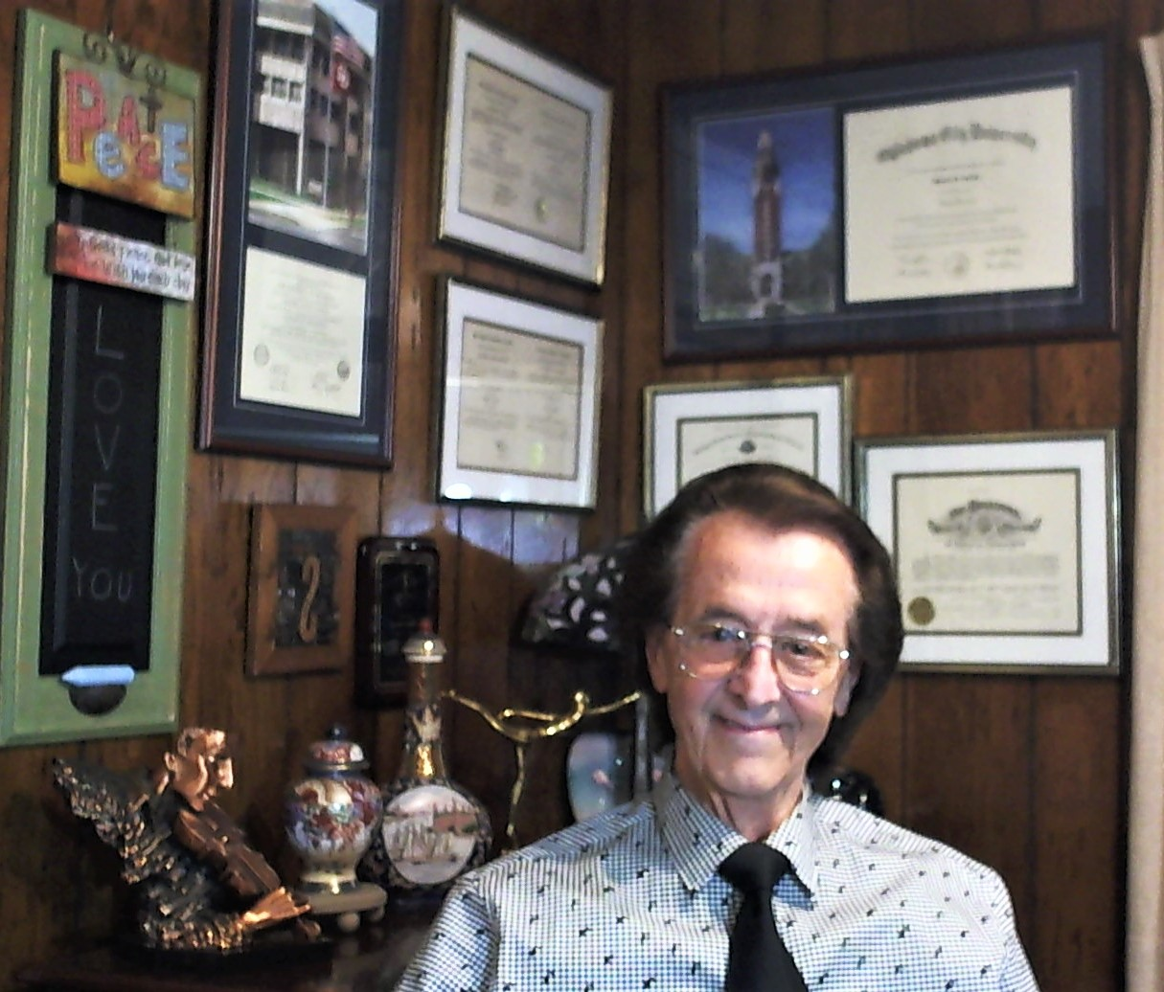
Advances in Healthcare Technology The Digital Doctor The Future of Medicine
Presented by:
Shafeek Sandy Sanbar,
MD, PhD, JD
FCLM, DABLM

Slide 2
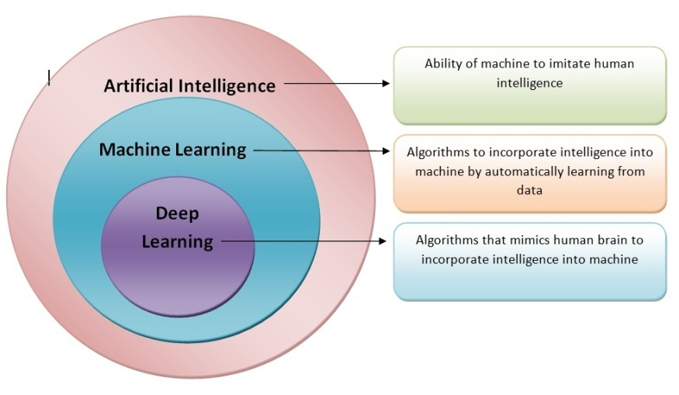
Healthcare Technology
(HealthTech)

Slide 3
Artificial intelligence (AI)
Performs Cognitive Skills –
Learning;
Reasoning; and
Self-Correction
Artificial Narrow Intelligence (ANI) or Weak AI
Artificial General Intelligence (AGI) or Strong AI
Artificial Super Intelligence (ASI) or Super AI

Slide 4
Machine learning
A subset of AI
statistical methods and algorithms
The accuracy of ML algorithms increases when it receives more data.
Pre-processed Data and Human Intervention

Slide 5
Deep learning
A subset of AI
Artificial neural network (ANN), or virtual nervous system
Artificial or virtual neurons
Convolutional Neural Networks, (CNN) and
Recurrent Neural Networks (RNN)
Raw Data (also called Big Data)

Slide 6
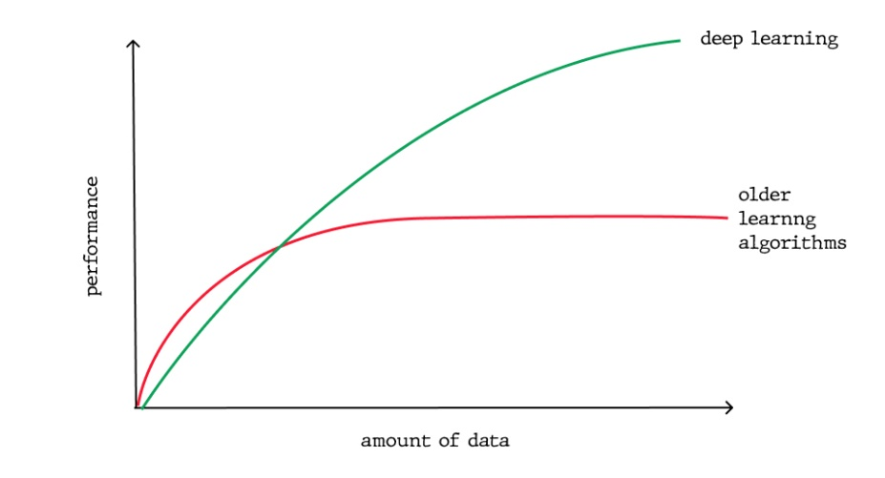
Raw Data or Big Data

Slide 7
Ethics of healthcare technology
Concerns about making diagnostic and treatment decisions via the technological advances of AI;
Doctors and patients prefer the personal touch;
Privacy and liability issues;
Inequity; Better virtual healthcare; Lack of transparency; Skepticism.

Slide 8
Decision making by physicians v. machines
Physicians commonly utilize ‘Experience’ or ‘Rule-based’ guidelines
AI uses ‘Evidence-’ or ‘Probability-’ based data for patient care.
Trust in AI systems
Medical professionals are stretched thin

Slide 9
Impact of ai on telemedicine
Center for Medicare/Medicaid Services (CMS)
In 2021, Barbosa and co-authors – Use of Telemedicine
improved access to care;
Improved health outcomes in select circumstances;
Has addressed geographical;
But less so social barriers to care

Slide 10
chatbots
Uses of Chatbots in Healthcare
Rule-Based
Use natural language processing (NLP)
Determines intent of the human caller, and what entity they are referring to.
Algorithm makes a query

Slide 11
Use of AI Systems in Healthcare
AI Systems:
Efficiently Diagnose and Reduce Error;
Help in Developing New Medicines;
Assist in Streamlining Patient Experience;
Mine and Manage Medical Data; and
Useful in Robot-Assisted Surgery.

Slide 12
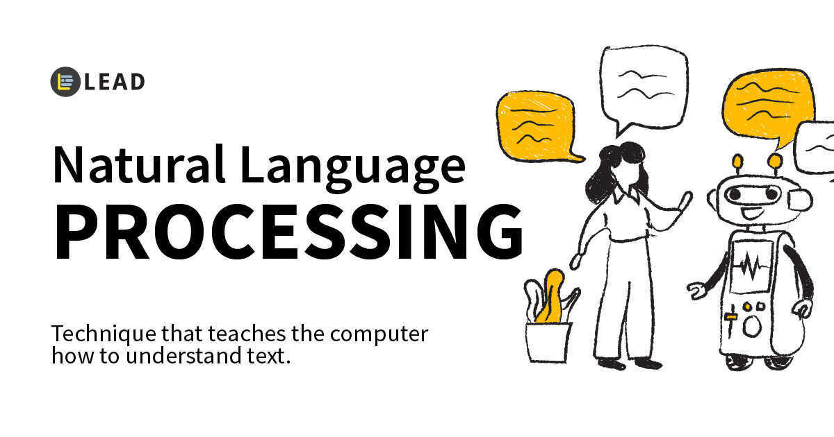
Branch of AI - includes speech recognition, text analysis, translation, and other goals related to language.
Accelerates review of medical records, and minimizes need for manual review
Accesses vast libraries of coding rules and classifications.
Minimizes coding errors.

Slide 13
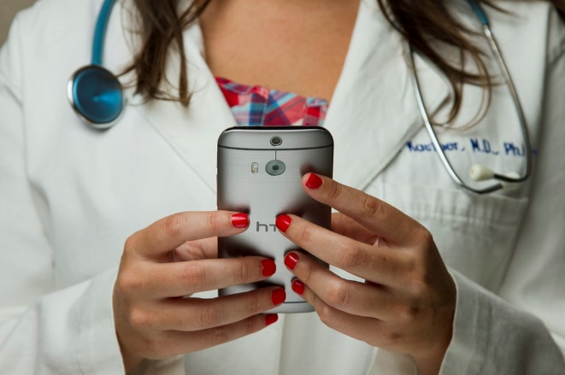
The Digital Doctor

Slide 14
The 21st Century Cures Act
Seamless and secure access, exchange, and use of electronic health information (EHI) by both patients and providers.
Ecosystem of new applications.
Standardized application programming interfaces (APIs).
Patients access to all of their EHI,
Implement information blocking.

Slide 15
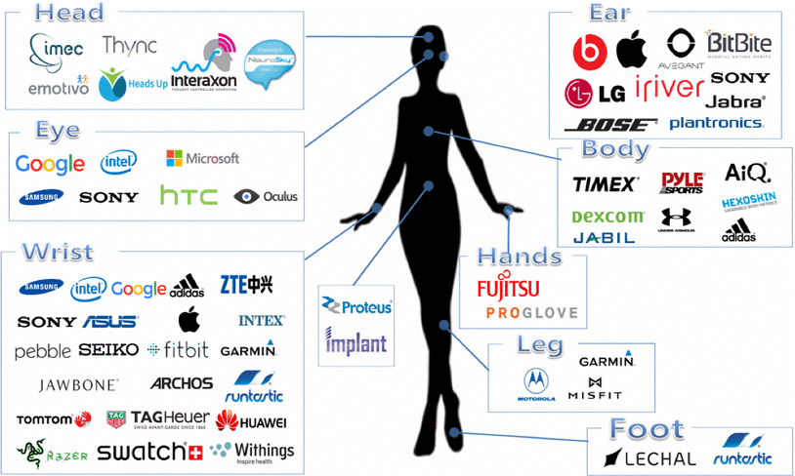
Companies Developing Medical Devices

Slide 16
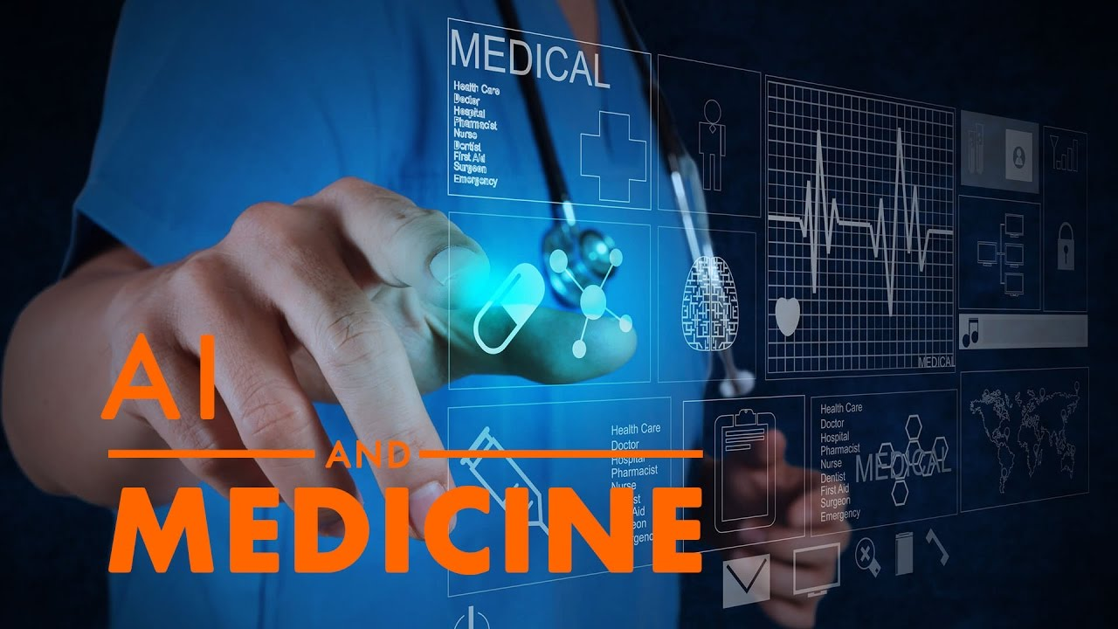
EHR – EMR: Role of Artificial Intelligence (AI)
Epic
NextGen,
MEDITECH,
Allscripts, and
Cerner

Slide 17
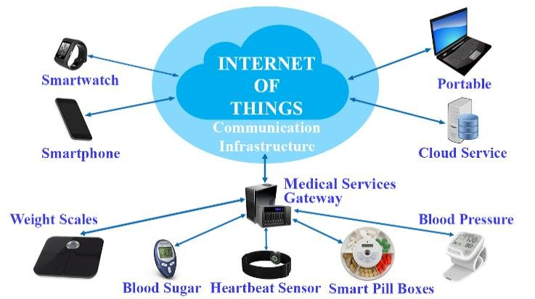
IoT - IoMT

Slide 18
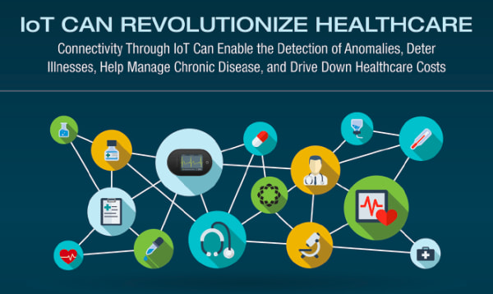

Slide 19
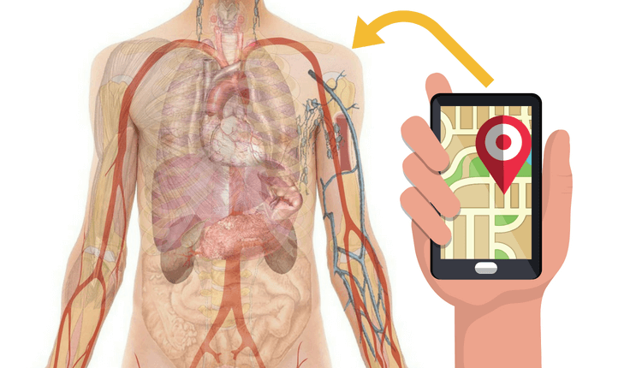
GPS Used for Tracking People and Internal Body Systems e.g. MIT “ReMix”

Slide 20
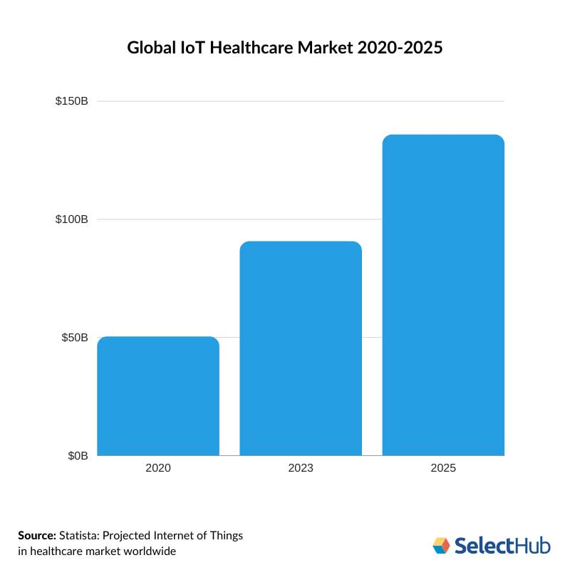

Slide 21
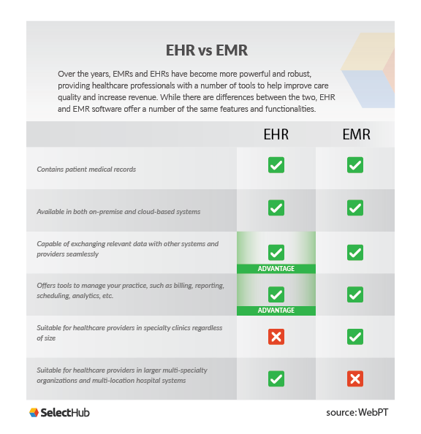

Slide 23
EHR EMR
Cost
Documentation Issues
Doctor Unfriendly
Need Improvement &
Further Development
Mont Saint-Michel on the Normandy coast of France

Slide 24
eHealthTech AI
I. Artificial Intelligence
Natural Language Processing
Knowledge Representation
Automated Reasoning
Machine Learning
Deep learning
Computer or Digital Vision
Robotics
II. Clinical Decision Support
III. Blockchain

Slide 25
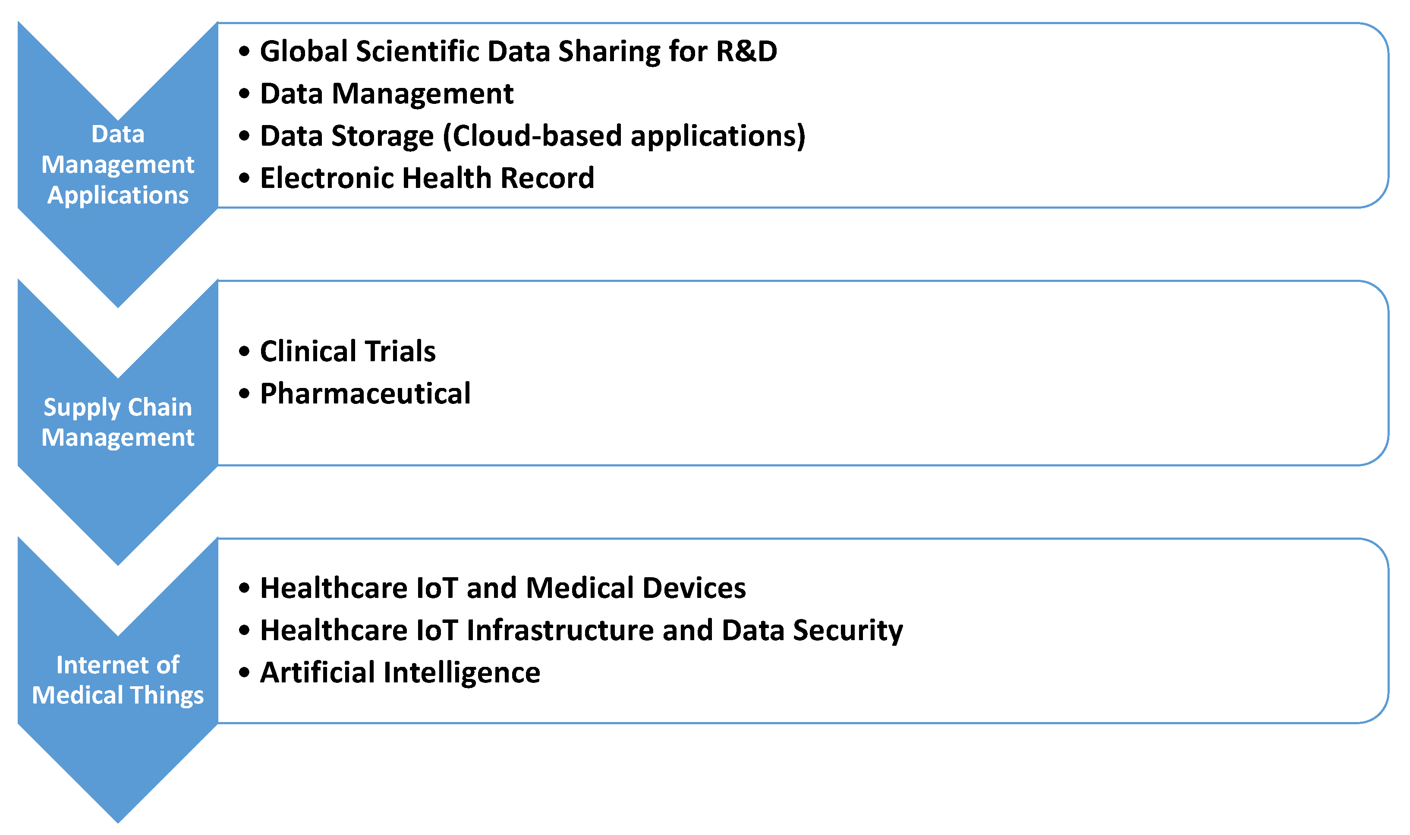
Blockchain-based healthcare applications.

Slide 26
Artificial Intelligence (AI) IBM Watson Innovation Center, in Munich, named after Thomas J. Watson, past president of IBM, helps analyze medical records for rare illnesses. In doing so, the system captures 200 million pages of text in three seconds.

Slide 27
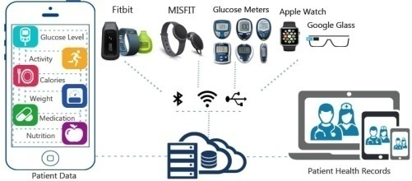
Wearable devices are being integrated with EHRs,

Slide 28
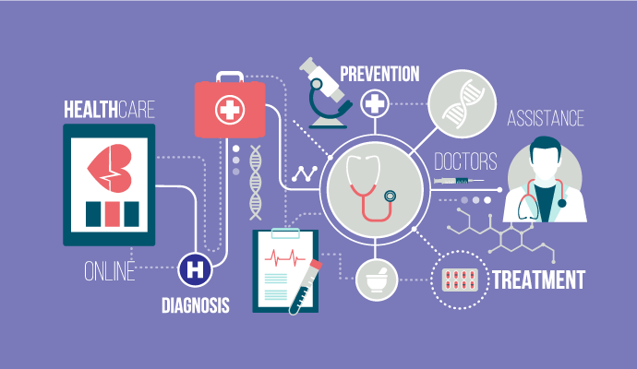
Top Technology Innovations Supporting EHR Optimization
Accessibility Interoperability Searchability Ease of Use
Standardization of EHRs Patient-centric Engagement

Slide 29
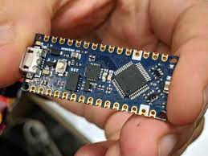
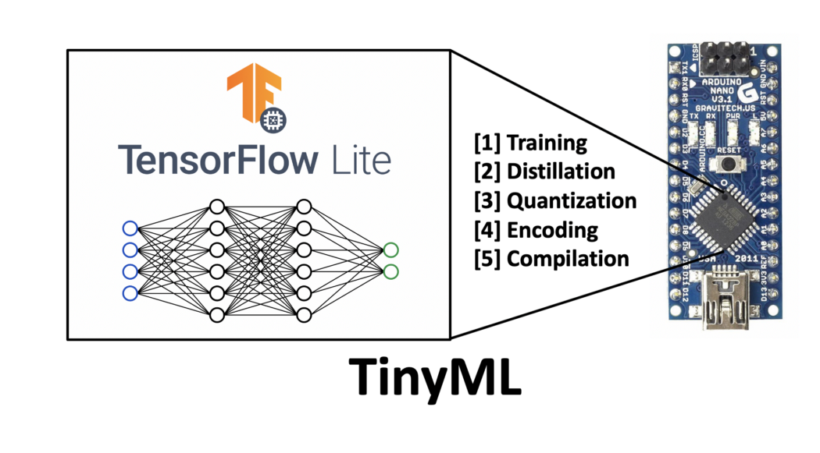
Tiny ML microcontroller

Slide 30
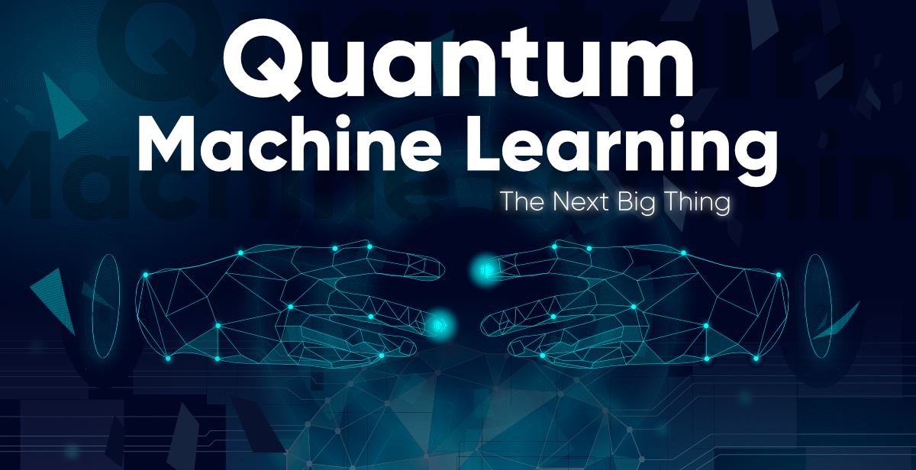

Slide 31
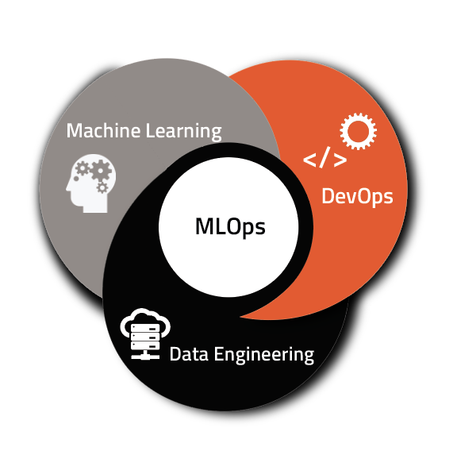
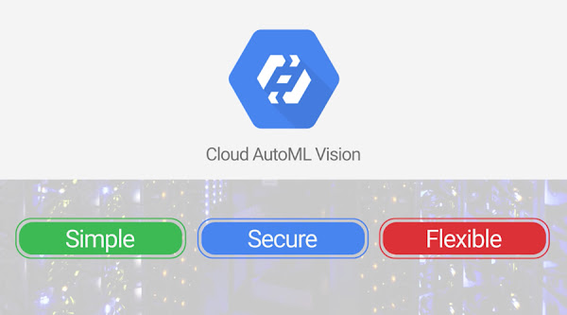
Auto ML and MLOps

Slide 32
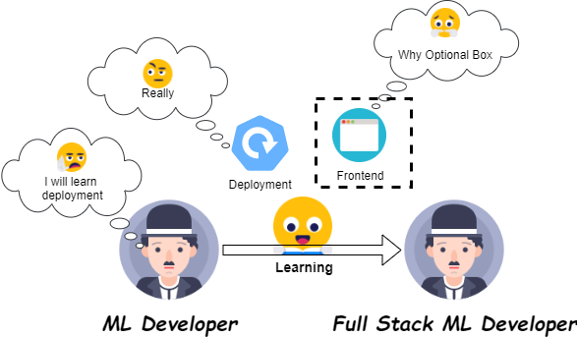
Full stack deep learning

Slide 33
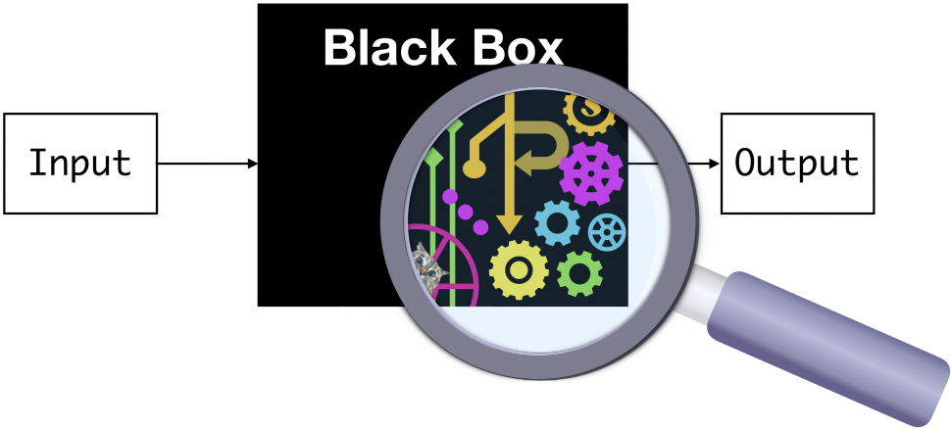
Inherently black box (developers cannot share the details of how the algorithm works in practice)
Deliberately black box (developers know but will not share the details).

Slide 34
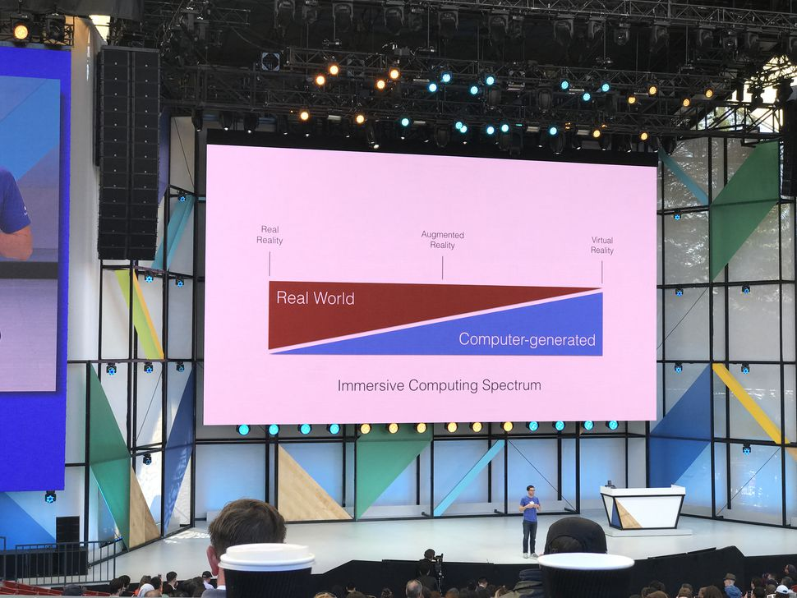
Acronyms
RR, VR, AR, MR, XR

Slide 35
Real Reality

Slide 36
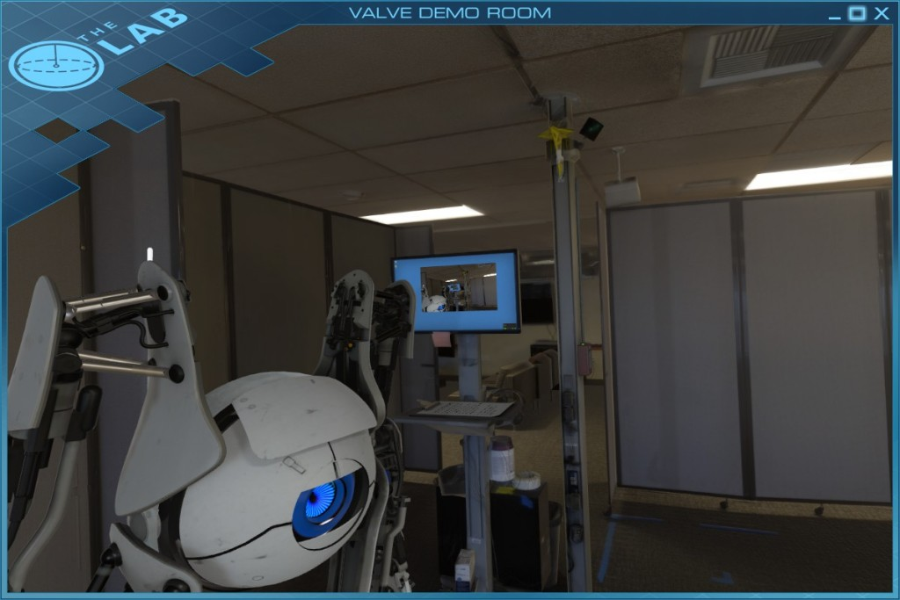
Virtual reality (VR): is technology that shuts the user away from RR, instead replacing every aspect of their reality artificially.

Slide 37
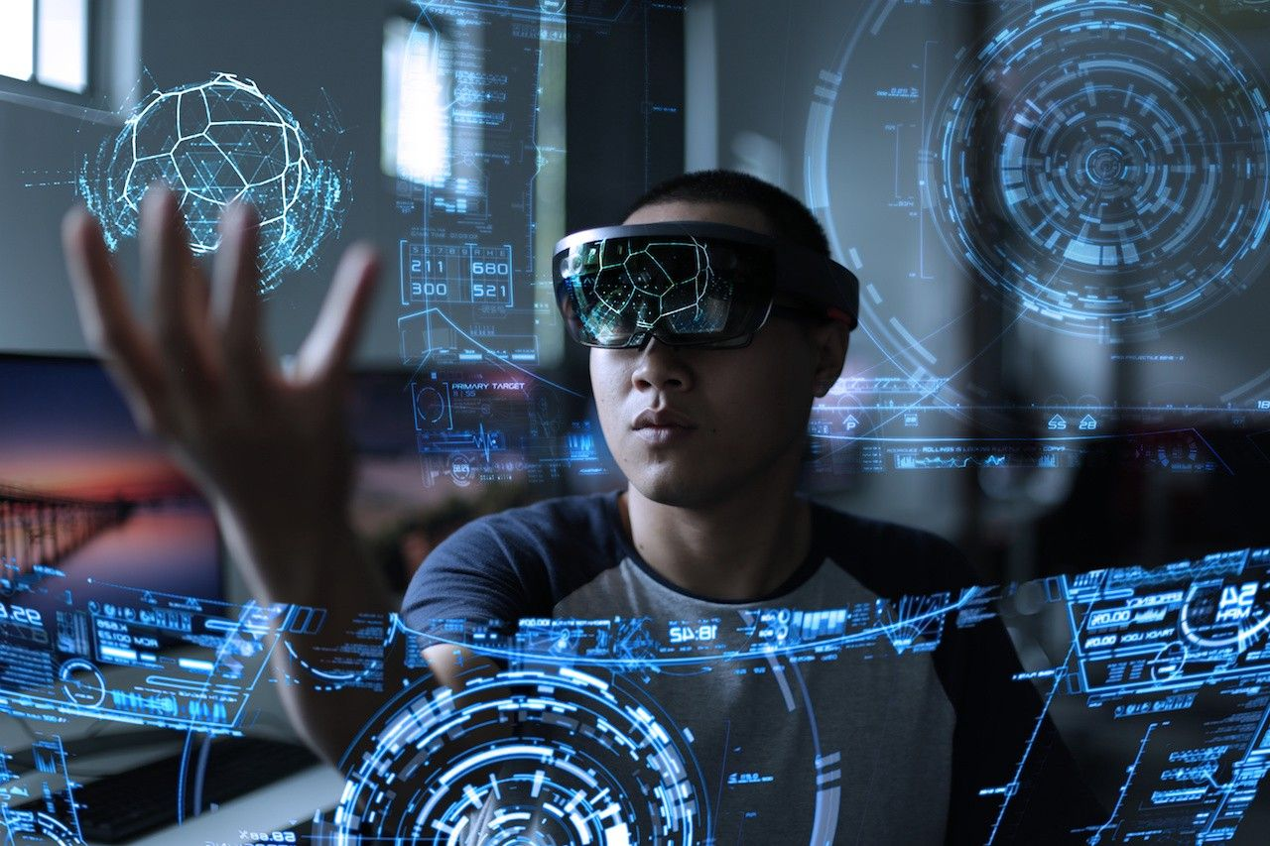
Virtual Reality

Slide 38
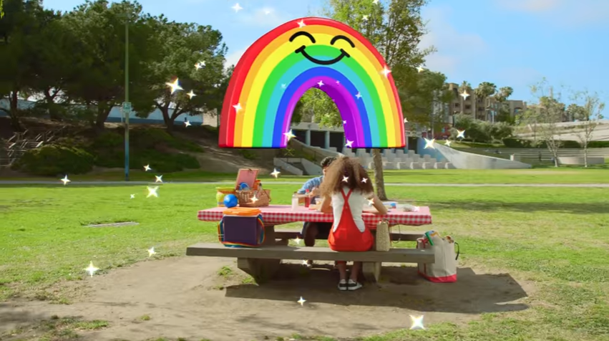
Augmented reality (AR):
Supplements real reality (RR) with computer generated imagery of any kind, such as Google Glass, smartphones, Nokia’s City Lens, Pokemon, Go or Snapchat.

Slide 39
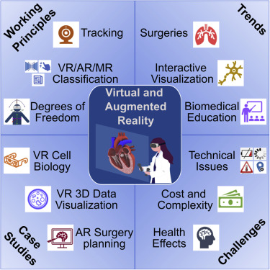

Slide 40
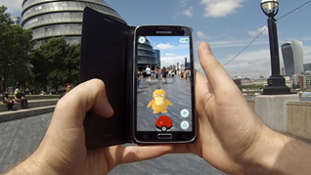
Mixed Reality (MR), a hybrid reality, merges real and virtual worlds to produce new environments and visualizations where physical and digital objects co-exist and interact in real time.

Slide 41
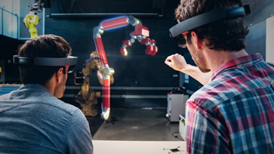
Extended Reality (XR) - all real-and-virtual combined environments and human-machine interactions generated by computer technology and wearables.

Slide 42
The virtual reality (VR) sociable network vTime XR allows users to meet, chat, and share with people around the world a cross-reality (XR) social experience - through augmented reality (AR).

Slide 44
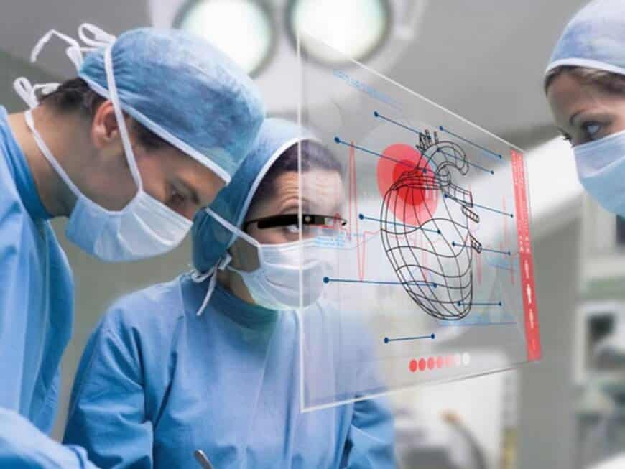
Analytics Insight
Extended Reality Enhancing Healthcare Industry
Extended Reality (XR) Innovation
Modern Healthcare

Slide 45
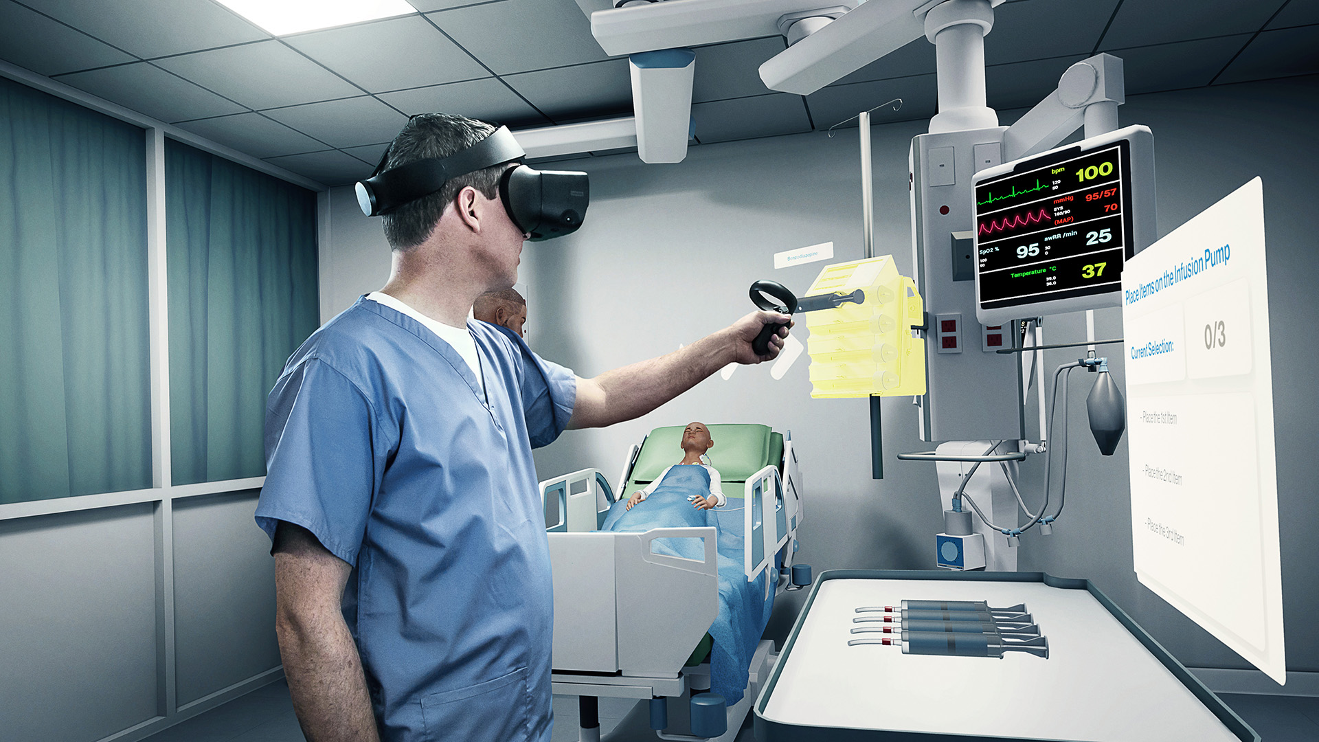
Immersive technologies from the gaming industry, are transforming the quality and availability of training and communication across the
healthcare
industry.

Slide 46
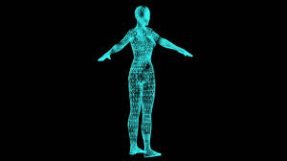
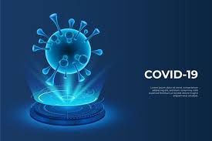
Holograms

Slide 47
MIT Using artificial intelligence to generate 3D holograms in real-time

Slide 48
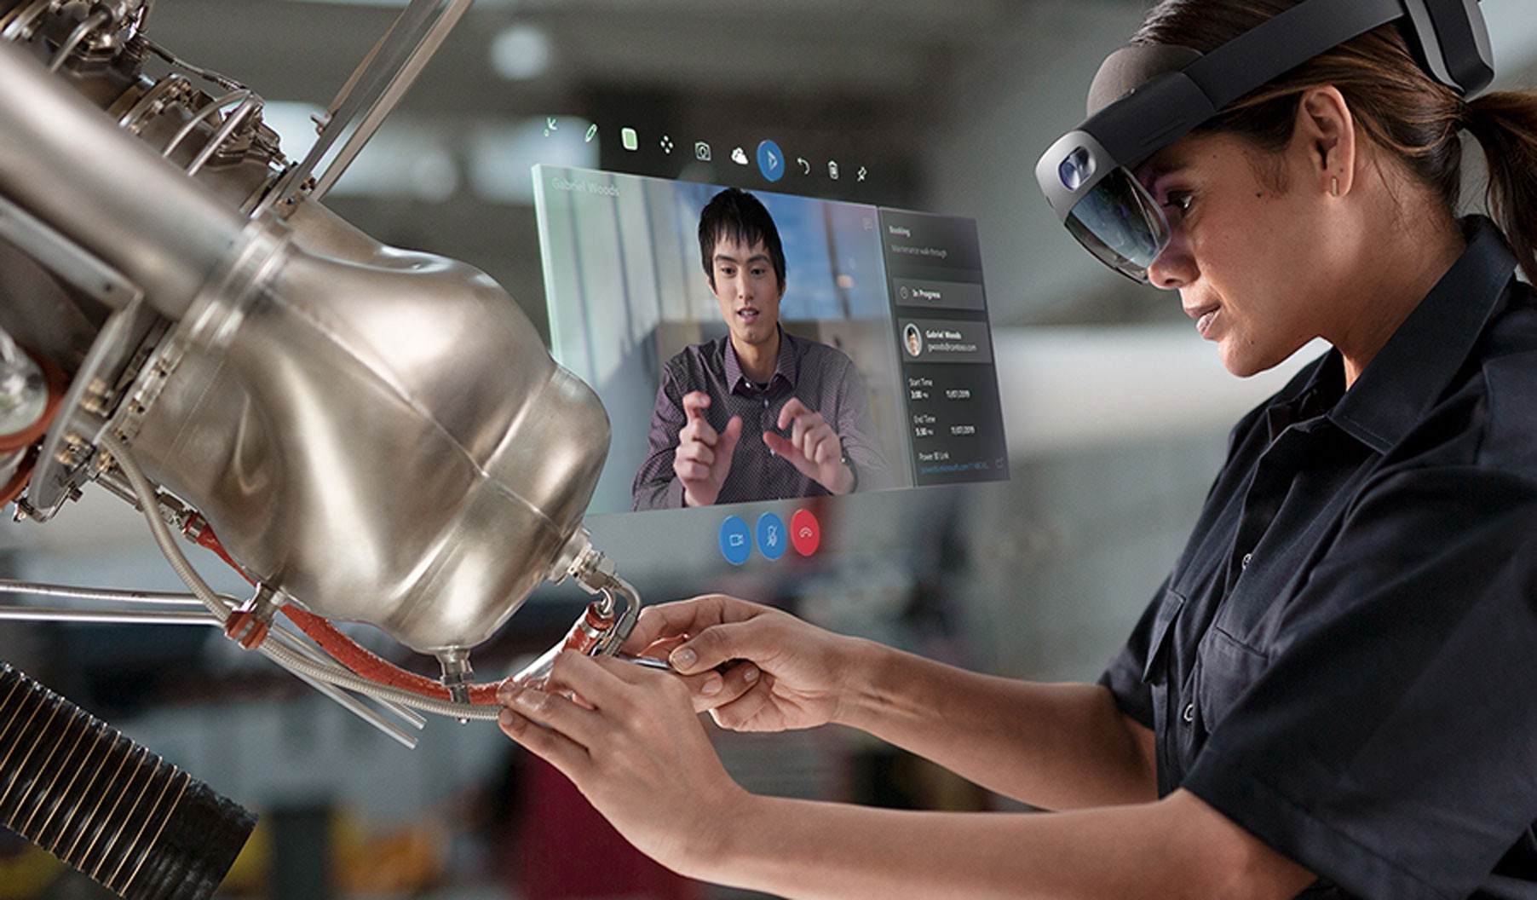
Combined AR and Hologram

Slide 49
Concluding remarks
2022, EHR/EMR adoption rates ~ 89%.
Documentation issues.
Improvements in EHR - patient engagement, accessibility, integration with the IoT, AI devices, wearables, digital vision, regulation and standardization.
Big changes - Novel AI devices and medical wearables, blockchain, remote patient monitoring and clinical decision support (CDS).

