Slide 1
Elder law

Slide 3
Elder law
Elder rights
Fiduciary duties
Capacity and competency
Informed consent and refusal
Powers of attorney
Abuse/Neglect
Medical malpractice

Slide 4
Elder rights - Introduction
NOT recognized as constitutionally protected class
Vast majority of protection of rights comes from State level statutes
FDR signed Social Security Act in 1935
Retirement, survivors’ benefits, disability insurance

Slide 5
Elder rights - History
Lyndon B. Johnson signed Social Security Amendments
Created Medicare and Medicaid
LBJ also created Older Americans Act
Authorizes grants at State level for community development, service, research, and other projects for Elders

Slide 6
Fiduciary duty of physician
Maintains confidentiality
Provides Care
Must be competent
Loyal to patients interest
Work in good faith
Act within scope of practice
Avoid conflicts of interest

Slide 7
Capacity and Competence
Capacity is defined as person’s ability to make an informed decision
Determined by physicians
Often best evaluated over a period of time
Competence is defined as degree of mental soundness needed to make decisions
Determined by a Judge

Slide 8
EXAMPLE: Oklahoma definition of capacity
18 years or older
Impaired by reason of mental or physical illness
Ability to receive and evaluate information effectively or communicate responsible decisions is impaired
A person for whom a guardian, limited guardian, or conservator has been appointed
Notes:
In Oklahoma, an incapacitated person means any person eighteen (18) years of age or older: 1. Who is impaired by reason of mental or physical illness or disability, dementia or related disease, developmental or intellectual disability or other cause; and, 2. Whose ability to receive and evaluate information effectively or to make and to communicate responsible decisions is impaired to such an extent that such person lacks the capacity to manage his or her financial resources or to meet essential requirements for his or her mental or physical health or safety without assistance from others, or 3. A person for whom a guardian, limited guardian, or conservator has been appointed pursuant to the Oklahoma Guardianship and Conservatorship Act.

Slide 9
Informed consent and refusal
Capacity must be determined by physician before informed consent can be obtained
Can be evaluated with Mini-Mental State Examination
Special case: recurring treatment
Generally, initial consent provides coverage for entire course of treatment
Initial discussion of consent should be thorough and ongoing

Slide 10
Powers of Attorney (POA)
Two types
General Power of Attorney
Durable Power of Attorney
Physicians should be prepared to discuss POA issues with patients and families
Physicians should document who the POA in medical record

Slide 11
Healthcare POA
Document outlining decision-making authority granted by the patient
Varies in degree of authority granted
Should be read very carefully by physician

Slide 12
Driver Safety
Between 2007 and 2016, elder drivers increased by 34%
Traffic fatalities for the same population went up by an average of 13%
Biggest risk factors: physical problems & cognitive impairments
Clinician’s Guide to Assessing and Counseling Older Drivers - Outlines primary prevention, secondary prevention, and tertiary prevention of driving disability

Slide 13
Legal Obligations to older driver
Two categories:
Potential liability based on lawsuits
Regulatory requirements based on laws governing licenses
Most states voluntary
Mandatory reporting: CA, DE, NJ, NV, OR, and PN
Communicate with patients as much as possible about concerns before reporting

Slide 14
Advance Care Planning and Directive
Advance care planning helps patients prepare for current and future decisions about their medical treatment and place of care.
Overall, patients are increasing utilizing advanced directives.
2014: Study 6,122 participants, aged 60 and older at death, had a significant increase in advance directive rates of completion, from 47% in 2000 to 72% in 2010. The proportion who had died in the hospital decreased from 45% to 35%.
Notes:
Describe what is included on an AD.
The Patient Self-Determination Act (PSDA), passed in 1990 and instituted on December 1, 1991, encourages all people to make choices and decisions now about the types and extent of medical care they want to accept or refuse should they become unable to make those decisions due to illness. The PSDA requires all health care agencies (hospitals, long-term care facilities, and home health agencies) receiving Medicare and Medicaid reimbursement to recognize the living will and power of attorney for health care as advance directives. The PSDA does not create new rights for patients but reaffirms the common-law right of self-determination as guaranteed by the Fourteenth Amendment. Under the PSDA, health care agencies must ask you whether you have advance directives and must provide you with educational materials about your rights under state law. Retrieved from: https://www.gapna.org/patient-self-determination-act-psda
14th Amendment: All persons born or naturalized in the United States, and subject to the jurisdiction thereof, are citizens of the United States and of the state wherein they reside. No state shall make or enforce any law which shall abridge the privileges or immunities of citizens of the United States; nor shall any state deprive any person of life, liberty, or property, without due process of law; nor deny to any person within its jurisdiction the equal protection of the laws.

Slide 15
ANOTHER Advance Directive study
In 2007, Teno et all examined the role of advanced directives 10 years after the Patient Self-Determination Act (PSDA).
70.8% had advance directives
Advance directives more likely in patients with hospice care or who lived in a nursing home and were less likely to have a feeding tube or be placed on a respirator at the end of life.
Notes:
Describe what is included on an AD.
The Patient Self-Determination Act (PSDA), passed in 1990 and instituted on December 1, 1991, encourages all people to make choices and decisions now about the types and extent of medical care they want to accept or refuse should they become unable to make those decisions due to illness. The PSDA requires all health care agencies (hospitals, long-term care facilities, and home health agencies) receiving Medicare and Medicaid reimbursement to recognize the living will and power of attorney for health care as advance directives. The PSDA does not create new rights for patients but reaffirms the common-law right of self-determination as guaranteed by the Fourteenth Amendment. Under the PSDA, health care agencies must ask you whether you have advance directives and must provide you with educational materials about your rights under state law. Retrieved from: https://www.gapna.org/patient-self-determination-act-psda
14th Amendment: All persons born or naturalized in the United States, and subject to the jurisdiction thereof, are citizens of the United States and of the state wherein they reside. No state shall make or enforce any law which shall abridge the privileges or immunities of citizens of the United States; nor shall any state deprive any person of life, liberty, or property, without due process of law; nor deny to any person within its jurisdiction the equal protection of the laws.

Slide 16
Failure to Comply with a Patient’s Advance Directive
Medically unethical and legally unprofessional to disregard a patient’s expressed wishes.
Due to this, patients’ or their representatives is legally with in their right to bring a civil action for damages under a variety of theories of recovery, including intentional assault and battery, medical negligence or wrongful life.

Slide 17
Be Mindful of EOL Situation
Withholding or withdrawing life support;
Providing unwanted life-prolonging treatment;
Patient-requested but not provided life-sustaining treatment;
Inadequately advising the patient about end-of-life issues;
Improperly obtaining consent for an organ donation;
Insufficiently worded advance directives, if obtained by the medical facility.

Slide 18
Pain and Symptom Management at the End of Life
At the end of life, there is a shift of priorities within patient care.
Comfort and quality of life becomes the focus, rather than cure and prolonging of life.
Interdisciplinary approach is vital during end-of-life care in order to meet the patient’s physical, mental, emotional, and spiritual needs.

Slide 19
The principle of double effect
Sometimes it is permissible to cause a harm as a side effect of bringing about a good result even though it would not be permissible to cause such a harm as a means to bringing about the same good end.
Example: the use of opioids in patients with End-Stage Heart Failure
The intent of the treatment is to alleviate pain, and not to cause the patient to die.

Slide 20
Discontinuation of Life-Sustaining treatments in Patients with no Advance Directives
Life-Sustaining treatments includes ventilator support, IV hydration, and nutrition given through an NG tube.
Landmark Cases involving Absence of Advance Directives
In re Quinlan: No civil or criminal liability if the guardian agreed to the withdrawal and a hospital ethics committee confirmed there is no reasonable possibility of the patient recovering a cognitive, sapient state
Notes:
Quinlan: PVS for years, father wanted to cease life-sustaining, hospital refused, father could make decisions on behalf of the daughter
Cruzan: parents wanted to stop life-sustaining treatments, hospital refused, treatment stopped, discussed with friends
Schiava: husband appointed guardian, parents disagreed, tried to get a TRO, denied, not against the 14th amendment
14th Amendment: All persons born or naturalized in the United States, and subject to the jurisdiction thereof, are citizens of the United States and of the state wherein they reside. No state shall make or enforce any law which shall abridge the privileges or immunities of citizens of the United States; nor shall any state deprive any person of life, liberty, or property, without due process of law; nor deny to any person within its jurisdiction the equal protection of the laws.

Slide 21
Discontinuation of Life-Sustaining treatments in Patients with no Advance Directives -2
Cruzan v Director, Missouri Dept. of Health: Substantive due process gives a competent person a federal constitutional right to refuse “death-prolonging procedures.”
In Re Schiavo: The District Court denied the Temporary Restraining Order. It also found no basis to sustain the parents’ substantive or procedural due process claims under the 14th Amendment
Notes:
Quinlan: PVS for years, father wanted to cease life-sustaining, hospital refused, father could make decisions on behalf of the daughter
Cruzan: parents wanted to stop life-sustaining treatments, hospital refused, treatment stopped, discussed with friends
Schiava: husband appointed guardian, parents disagreed, tried to get a TRO, denied, not against the 14th amendment
14th Amendment: All persons born or naturalized in the United States, and subject to the jurisdiction thereof, are citizens of the United States and of the state wherein they reside. No state shall make or enforce any law which shall abridge the privileges or immunities of citizens of the United States; nor shall any state deprive any person of life, liberty, or property, without due process of law; nor deny to any person within its jurisdiction the equal protection of the laws.

Slide 22
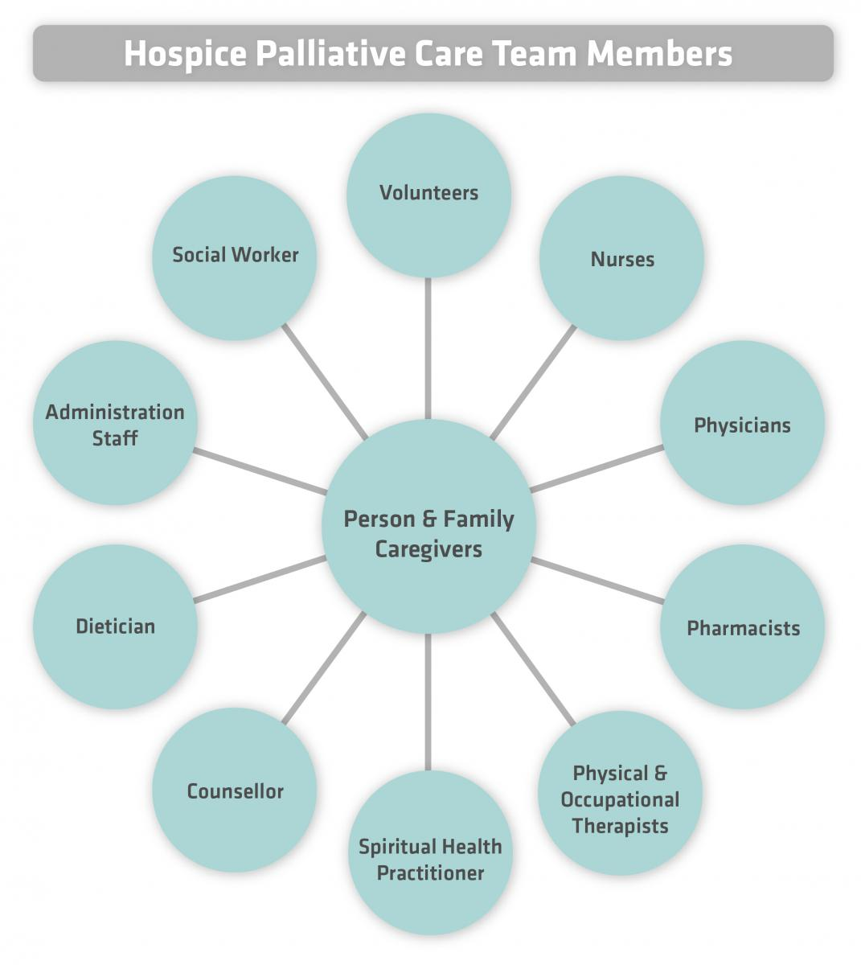

Slide 23
The Palliative Care team
Interdisciplinary team whose roles are:
Help patient get their affairs in order and draft or review their advance directives.
Inform patient about progression of disease and encourage end of life conversations with the patient and their family.
Talk about the patient’s priorities for the remaining time in their life.
Guide patients to set realistic goals for care, such as leaving the hospital, managing symptoms, spending time with family.

Slide 24
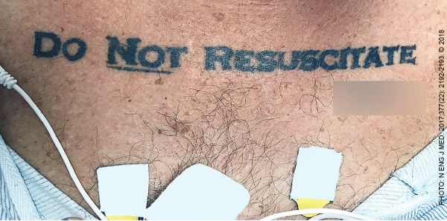
Types of DNR
Inpatient DNR
Signed by physician while patient is hospitalized.
Only applies to that facility.
Out-of-hospital DNR
Signed by the physician either during hospitalization or as outpatient.
Only needed if patient doesn’t want to be revived by paramedics.
Patient must keep this document with them at all times.

Slide 25
POLST (OR molst)
Physician’s Orders for Life-Sustaining Treatment (POLST)
Signed by a physician.
A set of medical orders that applies to a limited population of patients and addresses a limited number of critical medical decisions.
Should be used as a complement to an advance directive.

Slide 26
COVID-19, the Aging, and Long-Term Care Facilities (LTCFs)
Even before the COVID pandemic, infections are a major cause of hospitalization and cause deaths of 380,000 people every year.
The COVID pandemic has revealed many vulnerabilities and concerns pertaining to LTCFs.
Eight out of 10 COVID-19-related deaths reported in the United States have been among adults aged 65 years and older.
LTCFs have accounted for 42% of the COVID-19 deaths in the U.S.

Slide 27
Why have LTCFs been hit so hard by the COVID-19 Pandemic?
The tradition building structure and design of LTCFs make transmission from person-to-person easier, especially in highly contagious diseases such as COVID-19.
Long hallways with 40 rooms and 80 or more residents
Large dining rooms and common spaces
Residents frequently share rooms

Slide 28
Why have LTCFs been hit so hard by the COVID-19 Pandemic? (Cont’d)
The LTCFs workers might be inadvertently carriers of COVID-19.
Shortages of safety gear, and in some cases shortages of staff in general
Difficulty securing COVID test kits
LTCFs residents are generally older people with underlying health conditions.

Slide 29
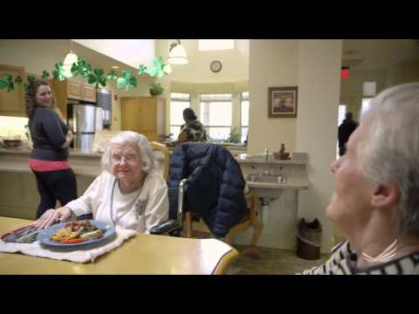
The Future of LTCFs
“Smaller-is-better” approach
Helps control infection AND has shown to significantly improve quality of life
Close off household more easily
Less staff per resident
Food preparation and laundry in the household
Notes:
Example: Green House Project
The Green House Project is a nonprofit organization that oversees 266 small-house nursing homes. Of the 243 projects that supplied data in early May 2020, eight reported having cases of Covid-19, and there were no deaths.

Slide 30
The Future of LTCFs (Cont’d)
Implementing infection-cautious protocols and disease control equipment
HEPA filters, ultraviolet light filters
Easy-to-clean, nonporous surfaces
Utilizing new technologies
Example: Green House Project - Nonprofit organization, oversees 266 small-house nursing homes. 243 projects supplied data in early May 2020. Eight reported having cases of Covid-19, and there were no deaths.
Notes:
Example: Green House Project
The Green House Project is a nonprofit organization that oversees 266 small-house nursing homes. Of the 243 projects that supplied data in early May 2020, eight reported having cases of Covid-19, and there were no deaths.

Slide 31
Malpractice Liability Post-COVID-19 Pandemic -1
Telemedicine/telehealth malpractice caused by incomplete exam, missing a change in a patient’s health status, or not following up with the patient in person, leading to a failure to diagnose action;
Issues involving medical record documentation, prescribing controlled substances, and interstate unlicensed practice;

Slide 32
Malpractice Liability Post-COVID-19 Pandemic - 2
Patient whose surgery was postponed due to prohibitions of elective surgery, but they prove subsequently to be necessary;
Claim that patients contracted Covid-19 at the physician’s office.

Slide 33
References
Clinician’s Guide to Assessing and Counseling Older Drivers. 3rd ed. American Geriatrics Society and National Highway Traffic Safety Administration. https://geriatricscareonline.org/ ProductAbstract/clinician’s-guide-to-assessing-and-counseling-older-drivers/8022. Published 2015
Sanbar SS. Legal Medicine Issues in the Aging: Part One. Journal of the Oklahoma State Medical Association. 2020,113(6): 329-333.
Sanbar, SS. “Legal Medicine Issues in the Aging - Part Two.” The Journal of the Oklahoma State Medical Association, 2020, 113(6): 334–338.

