Slide 1
ETHICS AND LAW Cognitive Assessment of Aging Doctors
S. Sandy Sanbar, MD, PhD, JD, FCLM, DABLM Executive Director and Past Chairman of the American Board of Legal Medicine; Past President, American College of Legal Medicine; Adjunct Professor of Medical Education, OUHSC

Slide 2
Disclosure
The Speaker has no financial interest to disclose.
No recommendations regarding the use of any commercial products.

Slide 3
KEY POINTS
Patient Safety and Quality of Care by Older Doctors
Evaluation of Doctors for Cognitive Impairment
Mandatory Screening and the Law

Slide 4
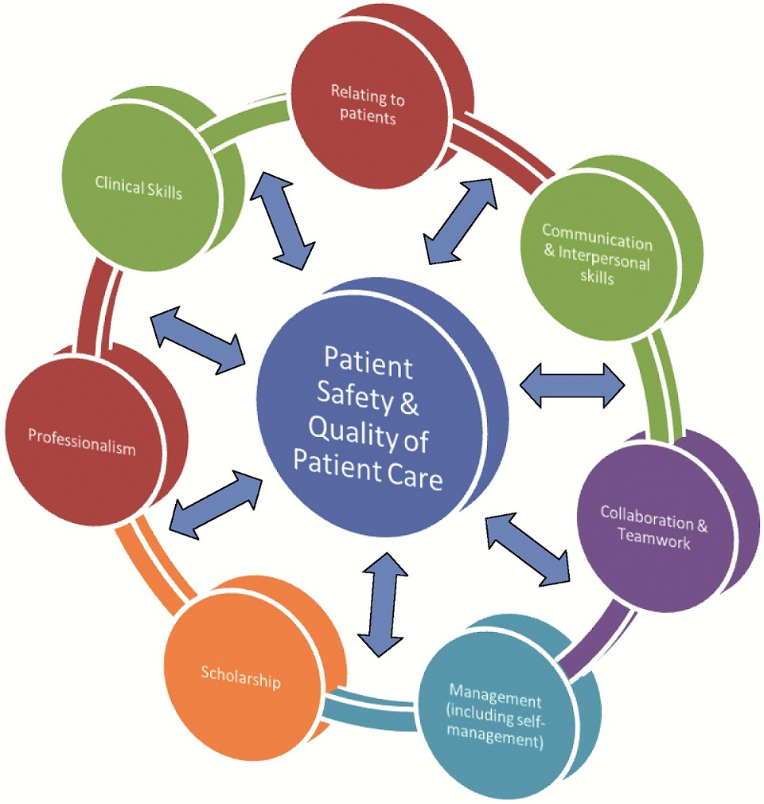

Slide 5
2020 Census of U.S. Doctors
FSMB: 1,018,776 licensed MDs and DOs.
Mean Age: 51.7 years;
30% over 60 years of age.
12-18% of people aged 60 or older are living with MCI, and
Of those with MCI, 10-15% go on to develop dementia each year.

Slide 6
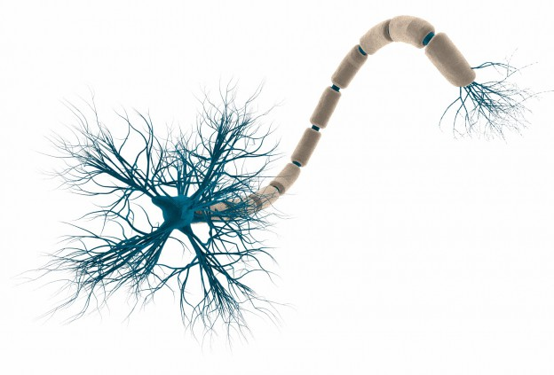
BRAIN: Normal Aging
Axon
Soma
With age, some areas of brain responsible for learning and complex mental activities decrease in size.
Nerve cell neurotransmission and communication gets weaker and less effective.
Blood flow to the brain can diminish.
Inflammation may increase as the body responds to an injury or disease.
Dendrite
Human Brain has
86 billion neurons
(Elephant Brain has
251 billion)

Slide 7
Total U.S.
Population in 2020
330+ millions
Ages 45 and above = 135 millions

Slide 8
Dr. Ron Brookmeyer
Preclinical (Asymptomatic) Alzheimer’s
46.7 million (35% ) US adults, age 45 years and above in 2017.
Many will not progress to clinical Alzheimer's during their natural lifespan.
Notes:
Dr. Ron Brookmeyer, professor of biostatistics, UCLA, reported that:
46.7 million Americans had preclinical Alzheimer's disease – – amyloidosis, neurodegeneration, or both. That represents 35% of US adults age 45 years and older.
Many of those people will not progress to clinical Alzheimer's during their natural lifespan.
In 2018, there were 6.08 million MCI or Alzheimer's dementia patients.

Slide 9
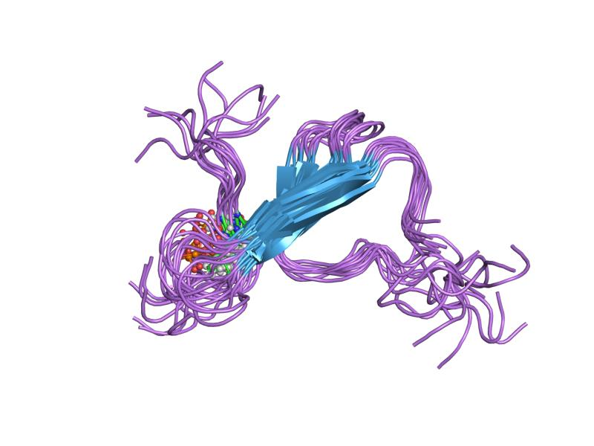
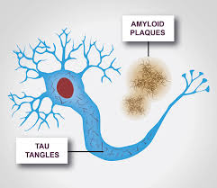
3-stages of Preclinical Alzheimer’s Last over 10 years
Normal cognition : (a) Amyloid
Normal cognition with: (a) Amyloid and (b) Tau
Subtle cognitive decline with: (a) Amyloid and (b) Tau
Tau

Slide 10
U.S. Population ~ 330 million
2017 | Pre-Clinical Alzheimer’s No Symptoms | ~ 46.7 million
2020 | Mild Cognitive Impairment (MCI) - Not Demented | 22.7 % ~ 75 million
2020 | Dementias | 11.3 % ~ 6.5 million

Slide 11
Types of Dementias No form of dementia is part of the aging process.
Alzheimer’s
LATE - limbic-predominant age-related TDP-43 encephalopathy
Vascular disease of Brain
Lewy Bodies
Fronto-temporal disease
Parkinson’s Disease
Mixed Dementia
Down’s syndrome
Normal pressure hydrocephalus
Huntington’s
Creutzfeldt-Jakob
Posterior Cortical Atrophy
Korsakoff syndrome
Notes:
Types of Dementia (Neurocognitive Disorders)
https://www.alz.org/alzheimers-dementia/what-is-dementia/types-of-dementia
TYPES OF DEMENTIA:
Alzheimer's disease - most common
LATE - Dementia is amnestic, usually in adults over 80 years. Limbic-predominant, Age-related, Transactive response DNA binding protein (TDP)-43 Encephalopathy
Dementia with Lewy bodies
Parkinson's disease
Frontotemporal dementia
Huntington's disease
Mixed dementia
Normal pressure hydrocephalus
Creutzfeldt-Jakob disease
Down's syndrome and dementia
Posterior cortical atrophy
Vascular dementia (Vascular cognitive impairment)
Korsakoff syndrome

Slide 12
KEY SYMPOSIUM - 2003 Mild cognitive impairment – beyond controversies, towards a consensus: report of the International Working Group on Mild Cognitive Impairment J. Int. Medicine 2004;256:240–246
General MCI criteria:
Person is neither normal nor demented;
Activities of daily living (ADL) are preserved and complex instrumental functions are either intact or minimally impaired; and
Evidence of cognitive deterioration shown by either objectively measured decline over time and/or subjective report of decline by self and/or informant in conjunction with objective cognitive deficits.
Notes:
In women, Alzheimer’s disease risk is increased approximately four times with one copy of the gene and 10 times with two copies of the APOE4 gene.
Men show essentially no increased risk with one APOE4 gene and only a fourfold increase in risk with two copies of APOE4.
Even in the absence of dementia, APOE4 is associated with significantly increased atrophy and dysfunction of the brain and that affects women much more strongly than men.

Slide 13
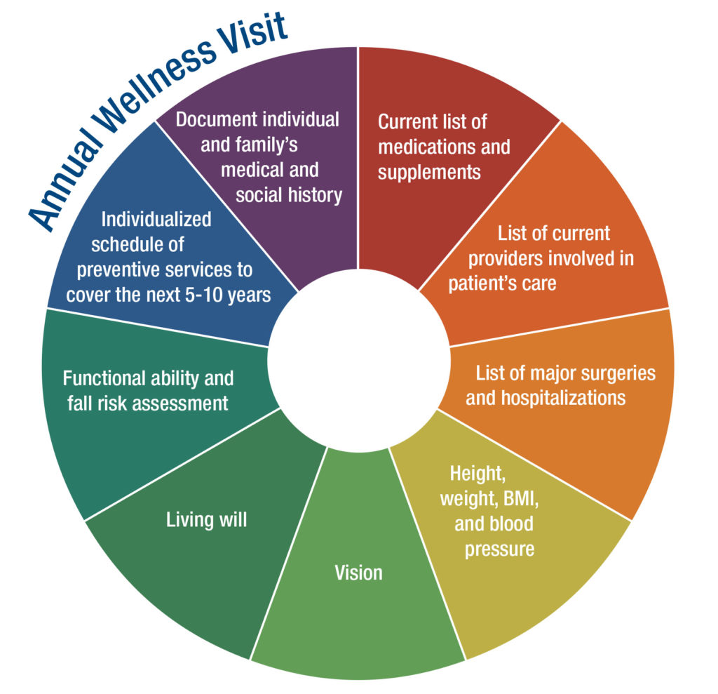
Notes:
The Annual Wellness Visit (AWV) is a yearly appointment with your primary care provider (PCP) to create or update a personalized prevention plan. This plan may help prevent illness based on your current health and risk factors.
During your first Annual Wellness Visit, your PCP will develop your personalized prevention plan. Your PCP may also:
Check your height, weight, blood pressure, and other routine measurements
Give you a health risk assessment
This may include a questionnaire that you complete before or during the visit. The questionnaire asks about your health status, injury risks, behavioral risks, and urgent health needs.
Review your functional ability and level of safety
This includes screening for hearing impairments and your risk of falling.
Your doctor must also assess your ability to perform activities of daily living (such as bathing and dressing), and your level of safety at home.
Learn about your medical and family history
Make a list of your current providers, durable medical equipment (DME) suppliers, and medications
Medications include prescription medications, as well as vitamins and supplements you may take
Create a written 5-10 year screening schedule or check-list
Your PCP should keep in mind your health status, screening history, and eligibility for age-appropriate, Medicare-covered preventive services
Screen for cognitive impairment, including diseases such as Alzheimer’s and other forms of dementia
Medicare does not require that doctors use a test to screen you. Instead, doctors are asked to rely on their observations and/or on reports by you and others.
Screen for depression
Provide health advice and referrals to health education and/or preventive counseling services aimed at reducing identified risk factors and promoting wellness
Health education and preventive counseling may relate to weight loss, physical activity, smoking cessation, fall prevention, nutrition, and more.
AWVs after your first visit may be different. At subsequent AWVs, your doctor should:
Check your weight and blood pressure
Update the health risk assessment you completed
Update your medical and family history
Update your list of current medical providers and suppliers
Update your written screening schedule
Screen for cognitive issues
Provide health advice and referrals to health education and/or preventive counseling services
Costs
If you qualify, Original Medicare covers the Annual Wellness Visit at 100% of the Medicare-approved amount when you receive the service from a participating provider. This means you pay nothing (no deductible or coinsurance).

Slide 14
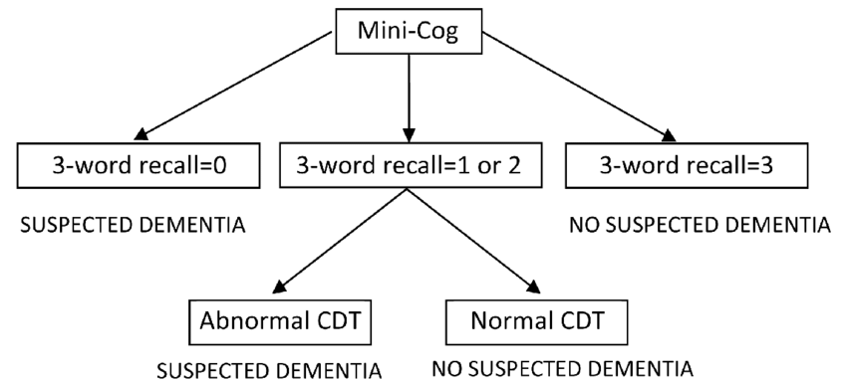
Screening Cognition Tests
Mini-Mental State Examination (MMSE)
Mini-Cog
Montreal Cognitive Assessment (MoCA)
St Louis Univ. Mental Status Exam (SLUMS)
AD8 Informant Interview
The Clock-Drawing Test for Alzheimer's
The Brief Alzheimer's Screening Test
The 7 Minute Screen
The SAGE At-Home Test for Memory

Slide 15
Imaging of Brain Structures
MRI - Magnetic Resonance Imaging - radio waves and strong magnetic field.
CT - Computerized Tomography – x-ray to produce slices of the brain.
PET - Positron Emission Tomography - radioactive tracer i.v. to reveal a particular feature in the brain.
Fluorodeoxyglucose (FDG) PET scans - show areas of the brain with poor metabolism.
Amyloid PET imaging - measures amyloid deposits in the brain.
Tau PET imaging – measures tau -neurofibrillary tangles in the brain.

Slide 16
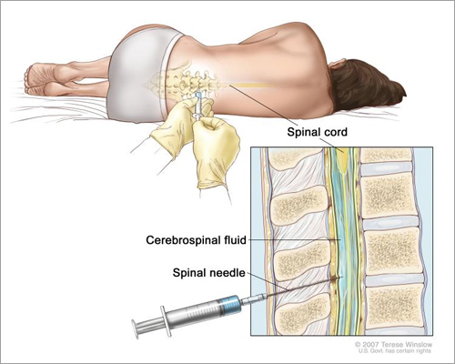
TESTS - Blood, Urine, CSF: Amyloid, Tau and Neurofibrils

Slide 17
Quality of Care by Older Doctors
1999, Hartz - Mortality rates of CABGs increased with increasing years of practice.
2000, O’Neill et al - Older surgeons performing carotid endarterectomy had higher mortality rates than younger surgeons.
2005, Neumayer et al - laparoscopic inguinal herniorrhaphy led to higher hernia recurrence rates when performed by older surgeons compared to younger surgeons.
2005, Choudhry et al - Older physicians have less factual knowledge
2006, Waljee et al - 461,000 Medicare patients who had major surgery. older surgeons had higher operative mortality rates for pancreatectomy, coronary artery bypass grafts and carotid endarterectomy relative to younger surgeons

Slide 18
2011, Southern et al - Inpatients of physicians with more than 20 years of practice had higher risk of mortality. 2013, Epstein et al - Fewer maternal complications in patients of obstetricians practicing for more decades. 2017, Tsugawa et al - 736,537 admissions managed by 18,854 hospitalist physicians and found higher mortality in patients treated by older physicians with lower volumes.
Quality of Care by Older Doctors (Cont’d)

Slide 19
Screening Physicians for MCI
2015, the AMA Council on Medical Education - voluntary screening procedures for physicians aged 70 years or older. 2018, voted down.
2018, Moore - Age-based screening program: “Singling out all older physicians for cognitive testing is empirically unjustified and legally prohibited. Empirically, there are more reliable ways to help identify and assist physicians, both older and younger, who pose risk to patients.”
2018, Katlic and Coleman, “Existing peer review processes are inadequate, and mandatory retirement ages are unfair and unscientific.”

Slide 20
Screening Older Physicians (Cont’d)
2016, the American College of Surgeons endorsed voluntary baseline physical and health assessments with subsequent re-evaluations.
2019, Society of Surgical Chairs (SSC) - Mandatory cognitive and motor testing of all surgeons by at least age 65.
2020, Whalley - “Systematic screening of the cognitive health of older physicians … is difficult to evaluate because clinical decisions rely on a spectrum of knowledge, comprising scientific evidence, experience, ethical principles, fairness, and personal values, this range varies among physicians.”
New Zealand; Canada; and United Kingdom.

Slide 21
Federal Law
I. Age Discrimination in Employment Act (ADEA)
It is “unlawful for an employer . . . to fail or refuse to hire or to discharge any individual or otherwise discriminate against any individual with respect to his [or her] compensation, terms, conditions, or privileges of employment, because of such individual’s age.”
Exception: Employers may set maximum age limits for employees if they can show that age is a bona fide occupational qualification (BFOQ) and is reasonably necessary for the operation of the business.

Slide 22
BFOQ
When evaluating a bona fide occupational qualification (BFOQ) case based on safety, a two-pronged test is applied:
whether the age limit is reasonably necessary to the overriding interest in public safety; and
whether the employer is justified in applying the age limit to all employees rather than deciding each case on an individual basis.

Slide 23
Federal Law
2. U.S. Equal Employment Opportunity Commission (EEOC)
“Age discrimination involves treating an applicant or employee less favorably because of his or her age.”
“An employment policy or practice that applies to everyone, regardless of age, can be illegal if it has a negative impact on applicants or employees age 40 or older and is not based on a reasonable factor other than age (RFOA).”
3. ADA - Americans Disabilities Act

Slide 24
State Statutory Law
Most states have age discrimination laws.
May 2019, Utah passed a law prohibiting certain age-based physician testing.
Court Decisions

Slide 25
COGNITIVE SCREENING For Late Career Physicians (LCPs)

Slide 26
Physicians >65 years of Age
CMS requires annual cognitive and driver’s safety assessment
Hospitals: mandating screening (some request medical records)
Physician self-reporting required for licensing and credentialing
Peers: required to report impaired doctors
Adverse Actions by hospitals against doctors are reported to NPDB
Outcomes: Retirement or limit practice with close monitoring.

Slide 27
Conclusion Mandatory screening of doctors is needed. It is best applied to all doctors over 40. The State medical licensing boards may play a major role in screening doctors along with other stakeholders including peers, hospitals, and medical organizations.

Slide 28
Thank You
S. Sandy Sanbar, MD, PhD, JD
Email: sandysanbar@gmail.com

