Slide 1
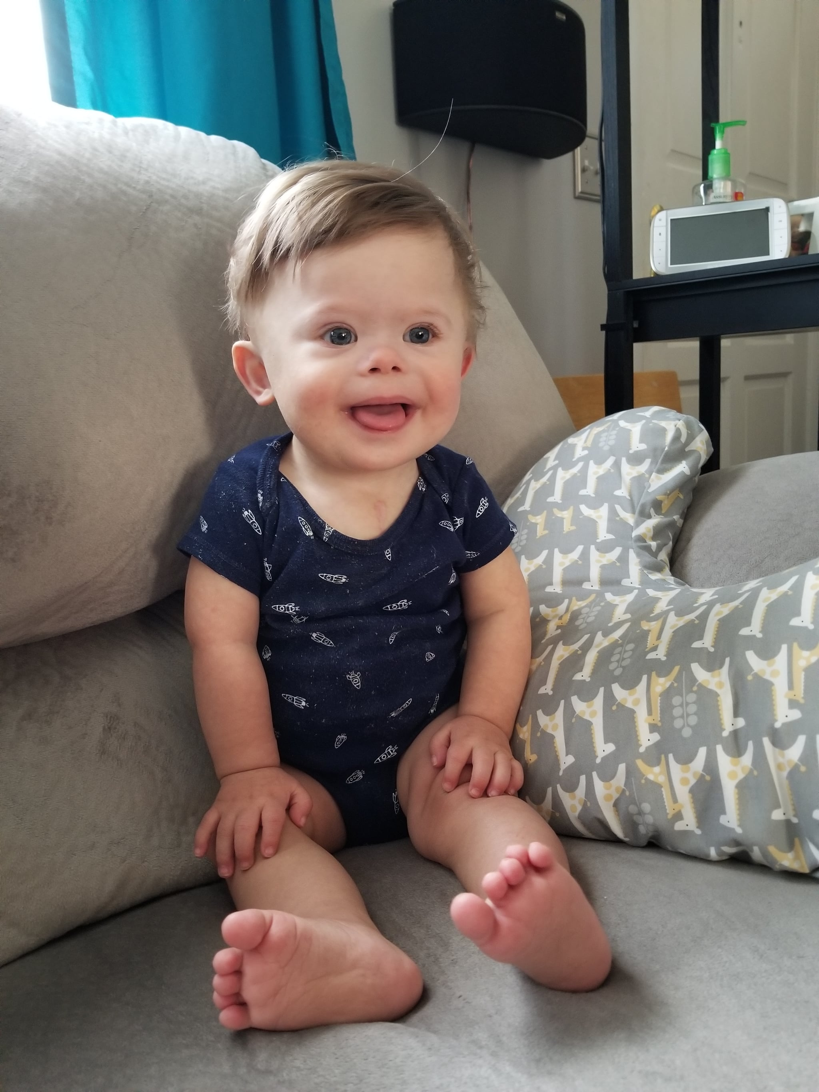
Loss of Chance of Survival
Infant – born with Down syndrome
Murmur at birth heard by pediatrician. Echocardiogram ordered.
Two days later, interpreted as significantly by cardiologist requiring cardiology consult and further imaging. Report faxed to hospital.
Cardiologist did not contact anyone at hospital to confirm receipt.
Murmur seemed to resolve. Baby was discharged.

Slide 2
Baby: Down Syndrome
Follow-up 2 days post-discharge – slight jaundice. No murmur.
10 days later – seen by pediatrician. Echocardiogram report not available
One month later – received immunizations. Not seen by pediatrician.
Parents relocated. Did not return to original pediatrician. No Echocg report.
Baby failed to thrive. Died at home at age 2.
Echocardiogram: Found in mother’s medical records.
Autopsy: same significant cardiac abnormalities as on Echocardiogram.
Claim filed. Case settled.

Slide 3
Case Discussion
Pediatrician: Follow up. No documentation of attempt to obtain report of echocardiogram
Cardiologist: Report to pediatrician. Check if report was received.
Hospital: Filing in mother’s chart. No copy to pediatrician.
Cause of action: Loss of chance of survival
Policies: Communicating abnormal results. Inpatient and outpatient
Communicating results to patients/relatives in a timely manner (portals)

Slide 4
How to Prevent such Lawsuits?
Prevent adverse events by having reliable systems in place and engaging in good communication between clinicians. Systems need to be designed for special conditions (such as a newborn with their mother's name attached to reports) and for assurances that the reports will follow the patient.
Evidence-based policies need to be in place for the communication of abnormal test results, like in this case, which was significantly abnormal but nonemergent at the time. As seen here, systems are needed both in hospitals and physicians' offices.
Preclude malpractice claims by having good communication with patients and families. Having patients and families aware of what to expect at home after discharge builds collaboration and trust.
Document - lack of documentation about attempt to obtain echocardiogram report

