Slide 1
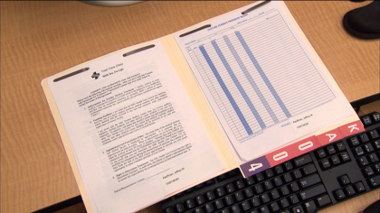
Medical Records – medical-Legal Aspects
S. Sandy Sanbar, MD, PhD, JD, FCLM, DABLM

Slide 2


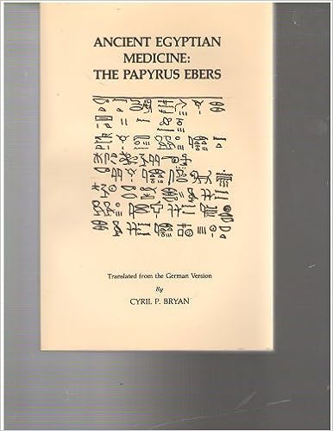
3000 B.C. Egyptian
1st Medical
Records (stone)
1500 B.C. ^{1st} Papyrus
Notes:
The earliest medical texts
The first civilization known to have had an extensive study of medicine and to leave written records of its practices and procedures was that of ancient Egypt. The oldest extant Egyptian medical texts are six papyri from the period between 2000 B.C. and 1500 B.C.: the Kahun Medical Papyrus, the Ramesseum IV and Ramesseum V Papyri, the Edwin Smith Surgical Papyrus, The Ebers Medical Papyrus and the Hearst Medical Papyrus. These texts, most of them based on older texts dating possibly from 3000 B.C., are comparatively free of the magician's approach to treating illness. Egyptian medicine influenced the medicine of neighboring cultures, including the culture of ancient Greece. From Greece, its influence spread onward, thereby affecting Western civilization significantly.

Slide 3

Imhotep was a revered healer, architect, High Priest, sager (wisdom, prudence, and good judgment), and adviser to King Djoser of Egypt. Born in Greece as a commoner, Imhotep became preeminent in his time in many fields.

Slide 4


Around 2780 BCE, King Djoser's architect, Imhotep, built the first pyramid by placing six mastabas, each smaller than the one beneath, in a stack to form a pyramid rising in steps.

Slide 5

Regarded as the citable treatise in the field, the 7th Edition of Legal Medicine explores and illustrates the legal implications of medical practice and the special legal issues arising from managed care.
The Editor is S. Sandy Sanbar and the American College of Legal Medicine Textbook Committee.
The 7th hard copy textbook was printed in 2007. It features comprehensive discussions on a myriad of legal issues that health care professionals face every day.
Next Textbook Edition 2024 Last E-Book Edition 2015

Slide 6
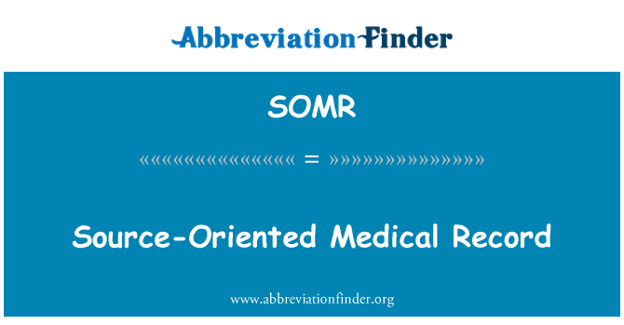
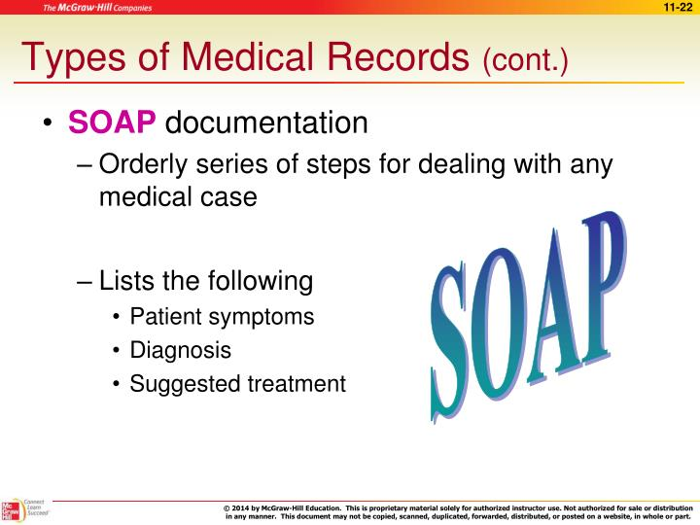

CHEDAR Format

Slide 7

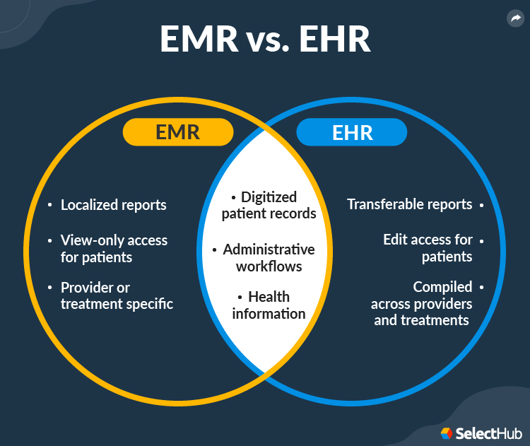

Slide 8
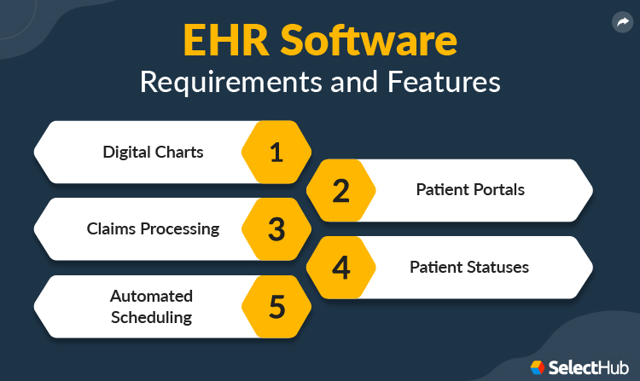

Slide 9
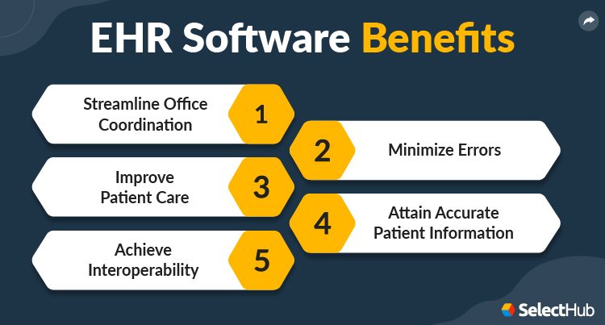

Slide 10
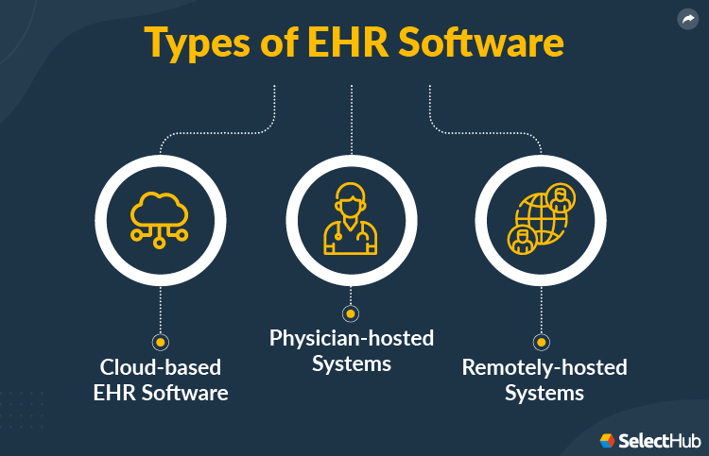
Notes:
Cloud-based EHR Software
The 21st century is often called the “age of the cloud.” Rightly so — cloud applications have been one of the breakthroughs of this century. Similar to all other industries, the medical sector has implemented cloud technology in various applications, including EHRs.
A cloud-based EHR allows you to store and access patients’ data online via the web. By opting for cloud-based EHR platforms, clinics can save overhead costs as third-party vendors handle the external servers — its security and any software updates.
Patients get unrestricted access to their medical profiles, though they are not allowed to edit them. Clinics can avail themselves of cloud services on a low-cost subscription basis. In addition, through cloud services, many clinics extend SaaS features and back-office services into a cloud network for patients to avail themselves. Clinics can save the additional cost that needs to be given to IT professionals otherwise to manage the on-premise systems.
Physician-hosted Systems
This type of application stores patient data on physicians’ or organizations’ servers. The traditional model of EHR programs, physician-hosted solutions, can be costly, as organizations must churn out capital for purchasing hardware and software. In addition, a clinic has to physically install the product onto a computer or server at the location.
This type of EHR platform has a principal downtime as you must shut down the infrastructure while installing updates and patches. You should use the physician-hosted EHR system if you own a large organization. Revenue should cover the overhead costs for purchasing and maintaining the program.
Remotely-Hosted Systems
This application stores patient data on the vendor’s servers instead of the physician’s server. This considerably cuts down the cost of handling hardware and software and is a more advanced technology than the traditional EHR product. ASPs usually help medium-sized businesses that have limited capital and want to avoid straight-up program purchase costs.

Slide 11
EHR
Security – Lack of trained users
Costly
Unfriendly to users
Time for training
Downtime – e,g., Power outages, hacking …
Electronic Health Record systems some challenges and limitations

Slide 12
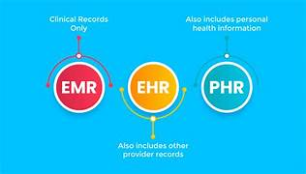
Both Paper and Electronic Medical Records must:
Be “ adequate”, “accurate” and “complete”, and Remain current,
Maintained in an accessible manner, Readily available for review,
Must be in full compliance with Federal and State Laws.

Slide 13


federal law, Rules & regulations
1974 - Federal Privacy Act
1992 - HIPAA: Introduced
1996 – HIPAA amended
2000 – Privacy Rule added
2003 – Security Rule effective
2004 – Office of National Coordinator (ONC)
2006 – HIPAA Enforcement Rule introduced
2009 – HITECH ACT* – became law
2011 – Office of Civil Rights (OCR)
2013 – Omnibus Final Rule adopted
2016 - 21st Century Cures Act
2019 – CMS audits
* Health Information Technology for Economic and Clinical Health Act

Slide 14

HHS ONC Rule
The 21st Century Cures Act federal law became law in late 2016,
  Interoperability - Compliance date was Decembere 31, 2023.
  Information Blocking – Compliance date was April 5, 2021.
  Health IT Certification Program by Office National Coordinator (ONC) – Compliance Date December 2023.

Slide 15
21st Century Cures Act also address mental health
The act calls for the following funding for mental health:
  $1 billion - opioid epidemic,
  $30 million for suicide prevention,
  $12.5 million for expanded crisis response capabilities, and
  $5 million maternal depression.

Slide 16
DEFINITIONS
USCDI – United States Code Data for Interoperability (Compliance 2023)
  Modern nationally standardized medical record as per Cures Act.
SDOH – Social Determinants of Health
(Compliance 2025) - Part of USCDI
    Economic stability, access, quality of care, neighborhood, environment, social and community context.

Slide 17
U.S. Core Data for Interoperability
(USCDI)
December 31, 2023 (Compliance date)
Vendors – must provide USCDI electronically, via
Application Program Interfaces (APIs) on mobile health apps.
All Electronic Health Information (EHI) falls under the Cures Act rule and must be made available upon authorized request from patients, providers, payers, and health information systems.

Slide 18
ONC & CMS rules apply to
Electronic Health Information (EHI)
EHI is defined as ePHI (electronic Protected Health Information) to the extent that it would be included in a designated class (domain or element) in USCDI.
Provider
Vendors
Third-Party
Apps
Insurers
Notes:
Payers
Patient claim and health data made available through APIs − Applies to MA, Medicaid, CHIP, Medicare FFS and QHPs
Patient data shared with other payers as they move from health plan to health plan

Slide 19
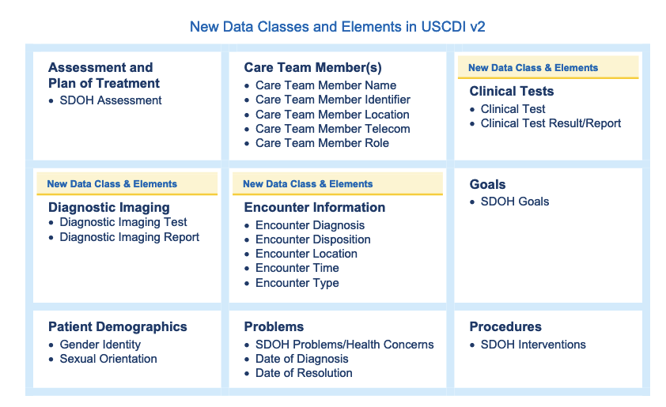
As of 2021

Slide 20
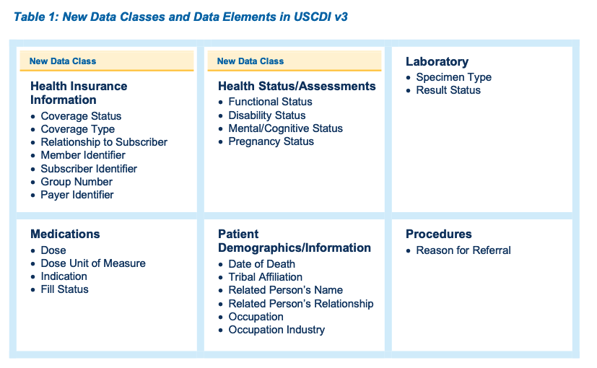
As of July 2022
The USCDI is setting the standard for healthcare data.

Slide 21
Overall goals of the rules
ONC (Office of the National Coordinator) and CMS
aim to shift the way the healthcare system shares data,
Moving from a system where healthcare organizations may share data under HIPAA/
To one where they must share data.
Notes:
Interoperability and Patient Access (CMS)¹ is focused on:
Standardizing and advancing electronic data exchange among healthcare stakeholders
Providing patient access to their Electronic Health Information (EHI) through Application Programming Interfaces (APIs)
Trusted Exchange Framework and Common Agreement (TEFCA) (ONC):
Provides technical and legal requirements to facilitate healthcare stakeholders to securely access and share EHI nationwide
Specifically prohibits “information blocking” (when a healthcare stakeholder impedes EHI exchange).

Slide 22
Definitions
Access: EHI is available for exchange or use.
Actor: Provider, health IT developer & health information network
Exchange: transmitted between technologies, systems, platforms, or networks.
Interference : prevent, materially discourage, or otherwise inhibit access to EHI. (e.g., Information Blocking)

Slide 23
Interoperability element
Interoperability elements are what:
(1) May be necessary to access, exchange, or use EHI; and
(2) Controlled by the actor.
They include - Hardware, software, integrated technologies or related licenses, technical information, privileges, rights, intellectual property, upgrades, or services that:

Slide 24
Permissible purpose
And USE
Permissible Purpose: purpose for which a person is authorized, permitted, or required to access, exchange, or use EHI under applicable law.
Once EHI is accessed or exchanged,
Use: is the ability for EHI to be understood and acted upon.

Slide 25
Electronic health information (EHI)
What’s included in a designated medical record.
EHI shall not include:
  (1) Psychotherapy notes; or
  (2) Information compiled in reasonable anticipation of, or for use in, a civil, criminal, or administrative action or proceeding.

Slide 26
EVALUATION OF claim or report of information blocking
Generally, a delay should be no longer than necessary to fulfill each patient’s request.
When assessing whether a delay may be information blocking, the facts indicate that an actor created unnecessary delays. That may be evidence of an actor's intent to interfere with, prevent, or materially discourage access, exchange, or use of EHI

Slide 27
delay in fulfilling a request for access, exchange, or use of EHI
If there is a delay in making EHI available through a “patient portal” or an application programming interface (API) for patients, that could constitute an interference and implicate the information blocking regulations.
E.g., An actor’s failure to submit EHI to public health authorities, as required by law (reporting statute), could be considered an interference under the information blocking regulations.

Slide 28
Interference
If a health care provider establishes one’s own organizational policy, it maybe considered an interference for purposes of information blocking, depending on the facts.
Examples of interference: delays are imposed on the release of lab results, for any period of time, before a patient can electronically access such results,
  In order to allow an ordering clinician to review the results, or
  In order that the clinician to personally inform the patient of the results.

Slide 29
“not” Interference with the access, exchange, or use of EHI if:
The information provided by actors focuses on any current privacy and/or security risks posed by the technology or the third-party developer of the technology;
The information is factually accurate, unbiased, objective, and not unfair or deceptive; and
The information is provided in a non-discriminatory manner.

Slide 30
Non-Certified vs. Certified EHR systems
Non-certified EHR systems do not typically have the capability to give patients direct & immediate access to their EHR via a mobile app or a patient portal.
If a patient wants immediate direct access, most solo or small practices may be able to rely on the infeasibility exception.

Slide 31

Q’s and A’s
Next Topic: Information Blocking

Slide 32
Information Blocking
The Office of National Coordinator [ONC]
for Health Information Technology [HIT]
21st Century Cures Act - Final Rule
https://www.healthit.gov/curesrule/resources/information-blocking-faqs

Slide 33
Information Blocking Definition
A practice by a healthcare provider, HIT developer, or HIE/HIN that is likely to interfere with, prevent, or materially discourage access, exchange or use of EHI,
Except as required by law or specified by the Secretary as a reasonable and necessary activity.
Notes:
Four actor categories – Providers, Vendors, HIE/Ns.
Payers – CMS rule applies
• We clarified in the final rule that the information blocking provision does not require actors to violate business associate agreements or associated service level agreements. However, we also clarified that such agreements could constitute an interference if used in a discriminatory manner by an actor to limit or prohibit the access, exchange, or use of EHI for treatment purposes that otherwise would be permitted by the Privacy Rule.
Provided certain criteria are met, we clarified in the final rule that it would not be considered an “interference with” the access, exchange, or use of EHI (and thus not “information blocking”) if an information blocking “actor” engaged in practices to educate patients about the privacy and security risks posed by the apps they choose to receive their EHI.
Penalties up to $1million for all actors except providers. Provider penalties will be announced in future rulemaking.

Slide 34
Information Blocking Exceptions
Involve not fulfilling requests to access, exchange, or use EHI:
  Preventing Harm Exception
  Privacy Exception
  Security Exception
  Infeasibility Exception
  Health IT Performance Exception
Involve procedures for fulfilling requests to access, exchange:
  Content & Manner Exception
  Fees Exception
  Licensing Exception

Slide 35
Infeasibility Exception to Information Blocking
“Infeasible Under the Circumstances”: Vendor does not offer the capability, or it is too costly to change EHR system.
For this exception, you would document that:
It would be infeasible to upgrade to a certified EHR;
due to the cost of such a system;
and the burden on your practice of changing EHR systems;
taking into consideration your practice’s available financial and technical resources.

Slide 36
Infeasibility Exception cont’d
“Segmentation: Can’t grant access because you can’t unambiguously segment (separate) the requested EHI from EHI that:
Cannot be made available either due to patient’s preference, or because the EHI cannot be made available by law; or
May be withheld under with Harm exception.
Potential applications: comingled test data, multiple patients

Slide 37
Privacy exception to Information Blocking
Denial of patient access to psychotherapy notes ⇢ not information blocking
Psychotherapy notes won’t be immediately available to patients without any warning to you.
In most states, patients can still access them, but they will be under the traditional system that allows you to review these notes and talk to the patient before providing access
Psychotherapy notes may also be useful if you need time to sort out multiple patients, minor proxy issues

Slide 38
Preventing Harm Exception to Information Blocking
Refusing to disclose EHI where that would endanger the life or physical safety of a patient or another person
Determination based on current or prior psychologist-patient relationship

Slide 39
Recordkeeping/Patient Communication Strategies for Adapting to Immediate Direct Patient Access
Keep lean records → “minimum necessary” and/or psychotherapy notes • Document with the expectation that patients will read it w/o your knowledge or ability to offer context & explanation
For proxy or multiple patients:
  Provide clear explanation to patients/proxies
  Written agreement re what goes in whose EHR and who has access
  Clear policy for yourself re segregating EHI that aligns with the parties’ agreement/understanding
Offer ability to request restrictions for patients who wish to limit access to their sensitive information

Slide 40
Resources - ONC Rule and CMS Rule
  ONC Rule
    For more information on the ONC final rule, please visit: https://healthit.gov/curesrule
    To view the ONC final rule, please visit: https://healthit.gov/curesrule
  CMS Rule
    For more information on the CMS final rule, please visit: https://www.cms.gov/newsroom/fact-sheets/interoperability-and-patient-access-fact-sheet
    To view the CMS final rule, please visit: https://www.cms.gov/Regulations-and-Guidance/Guidance/Interoperability/index

Slide 41
Q’s and A’s
Next Topic: Release of information (ROI)

Slide 42

Next Topic

Slide 43
Why Do People Request the
Release of Information?
Patients will keep personal health record
Healthcare providers usually request medical records.
Attorneys and legal representatives - subpoena requests for medical records
Insurance companies also request medical records for cases they’re working on
Government agencies to evaluate and process benefit claims and to conduct compliance audits. Licensing Board

Slide 44
ROI Process for Medical Records
Phase 1: Recording, Tracking, and Verifying the Authorization
Requestors fill out a HIPAA-compliant authorization form as per Privacy Rule.
30-day timer begins before the organization may incur Right of Access Initiative penalties.
When releasing PHI, diligently track every part of the ROI process to protect your organization in the case of an audit.
Must document requests that do not require patient authorization.

Slide 45
ROI Process for Medical Records
Phase 2: Retrieving Requested Medical Records for ROI
Organization verifies signed authorization form.
Requestor outlines date range and nature of the treatment.
Follow minimum necessary standard - Only collect medical records specifically requested for ROI. Request for all records on file without listing out each visit, as “All” is specific.
ROI professional searches for the medical records - may be a paper, microfilm, or electronic format and may be located onsite or offsite.

Slide 46
ROI Process for Medical Records
Phase 3: Safeguarding Sensitive Information
ROI professional who retrieved medical records carefully examines every image or page.
If the request does contain PHI they cannot legally release.
If it doesn’t, they double-check that all pages, images, and dates of service are correct.
To avoid any errors, some perform a double-QA process.

Slide 47
ROI Process for Medical Records
Phase 4: Releasing Requested PHI
Security and compliance restrict how healthcare providers can release records.
ROI staff must be careful to avoid engaging in information blocking per the Cures Act.
To protect healthcare providers from feeling forced to unlawfully release records, the Cures Act includes eight information blocking exceptions.

Slide 48
ROI Process for Medical Records
Phase 5: Request Fulfillment and Invoicing
Billing: ROI team can price billable requests. Cost calculation is based on a combination of federal, state, and local statutes that limit the maximum lawful price.
Some organizations choose to not charge their reasonable, cost-based ROI fees for medical records.
  The ROI process can take medical professionals hours with traditional methods like fax, which makes keeping up with requests challenging.

Slide 49

Key considerations for “ROI” Billing
Familiarize and understanding the applicable regulations and guidelines,
Establishing appropriate fee structures, for processing requests, copying fees for duplicating records, and mailing or delivery fees,
Maintaining patient privacy and security,
Implementing efficient processes, and
Documenting all relevant actions and communications related to the ROI.

Slide 50

Patients’ Rights under HIPAA
Ability to access, amend, and request restrictions on the use and disclosure of their medical records.
HIPAA legally empowers patients to obtain copies of their medical records or have them transmitted to designated individuals or entities.

Slide 51

ROI State Laws
State laws significantly impact how healthcare providers charge for medical records.
May differ from one state to another, impacting fee structures, timelines, and requirements for record release.
Must comply with State law.

Slide 52

types of “ROI” Requests
Patients’ requests are covered by HIPAA’s reasonable cost-based fee limitations.
Patient-Directed Requests to a third party, (doctor provider during care coordination and requests from other doctorsnon-billable.
Third-Party Requests: Insurance companies, attorneys, and other third parties may need access to medical records for various purposes. These may include claims processing, disability insurance, worker’s compensation, and more. These professionals aren’t covered by HIPAA’s reasonable cost-based fee limitations, so state laws set the limit for their requests.

Slide 53
Q’s and A’s
Next Topic: HIPPA Compliance

Slide 54

HIPPA Compliance
What areas have been identified by the HHS Office for Civil Rights as essential elements of an effective HIPAA compliance program?
Required Annual Audits/Assessments

Slide 55
1. There are six Required Annual Audits/Assessments
Security Risk Assessment
Privacy Standards Audit (Not required for BAs)
HITECH Subtitle D Privacy
Audit Security Standards Audit
Asset And Device Audit
Physical Site Audit

Slide 56
2. Document Gaps
Identify all gaps uncovered in the audits Required Annual Audits/Assessment.s
Document All Deficiencies

Slide 57
3. Remediation plans
Create remediation plans to address deficiencies found in all six Audits.
The remediation plans should be fully documented in writing.
Update and review these remediation plans annually.
Retain for six years the records of the annually documented remediation plans.

Slide 58
4. Staff training
All staff members should undergo annual HIPAA training
Document the staff training.
Designate a staff member as the HIPAA Compliance, Privacy, and/or Security Officer.

Slide 59
5. Policies and Procedures
Must have Policies and Procedures relevant to the annual HIPAA Privacy, Security, and Breach Notification Rules.
All staff members must read and legally attest to the Policies and Procedures.
Documentation of the staff members legal attestation.
Document annual reviews of your Policies and Procedures.

Slide 60
6. Vendors and business associates
Identify all your vendors and Business Associates.
Have Business Associate Agreements in place with all Business Associates.
Perform due diligence on your Business Associates to assess their HIPAA compliance
Track and review your Business Associate Agreements annually
Have Confidentiality Agreements with non-Business Associate vendors

Slide 61
7. HIPAA breaches (violations)
Have a defined process for incidents or breaches
Have ability to track and manage the investigations of all incidents.
Be able to provide the required reporting of minor or meaningful breaches or incidents.
Your staff members should have the ability to anonymously report an incident.

Slide 62
Q’s and A’s
Next Topic: Breaches of Compliance, Fraud and Abuse

Slide 63
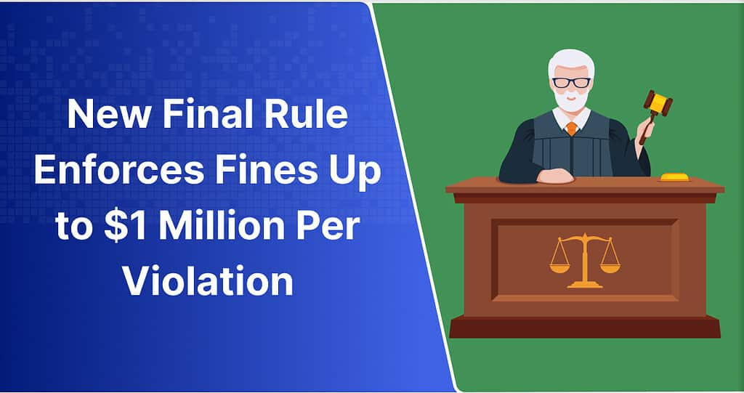

Slide 64
HHS OIG Information Blocking Final Rule Implements Penalties
HHS defines information blocking as “a practice by an ‘actor’ (any Healthcare Provider) that is likely to interfere with the access, exchange, or use of electronic health information (EHI)” with some exceptions.
Applies to:
  (1) Developers of certified health IT; (2) Organizations that offer certified health IT;
  (3) Health information exchanges; (4) Health information networks.
There will be a Separate rule with penalties for providers.

Slide 65
How Will the OIG Investigate Information Blocking Claims?
OIG will prioritize cases that:
Is, has, or could harm the patient
Detrimented provider’s ability to provide patient care
Continued for a long time
Financially impacted government or private entities
Knowingly involved information blocking

Slide 66
OIG process followed for investigating each information-blocking claim
Investigation: OIG will gather information, conduct interviews, and document the situation before discussing with accused entity.
If the investigation reveals the entity committed information blocking, OIG will send them a demand letter.
Entity may then appeal the penalty if they believe the investigation is incomplete, incorrect, or too severe.
In the case of an investigation, cooperation, and action are crucial for minimizing penalties. (Seek legal counsel.)

Slide 67
Medical Fraud & Medical Abuse
  Fraudulent billing
  Over-billing
  Unnecessary testing

Slide 68
Medical Fraud
Intentionally billing for services never rendered
Misrepresentation of diagnosis to justify payment of services

Slide 69
Medical Fraud (Cont’d)
Falsifying medical necessity
Unbundling or “exploding” charges
Upcoding services
Intentionally duplicating billings

Slide 70
Abuse
Unknowing or unwillful misrepresentation
Unintentional misuse of modifiers
Inadequate documentation of medical services sufficient to justify payment
Non-compliance with participation agreement

Slide 71
False Claims Act (FCA)
31 USC 3729-33
False claim submission
  Claim - Request for money or property that is funded by the federal government
  Knowingly submit false or fraudulent claim
  False statement to get a false or fraudulent claim approved
Penalties
Qui Tam actions

Slide 72
FCA - “Knowingly” means:
Actual knowledge
Deliberate ignorance
Reckless disregard
  Specific intent to defraud is not required
  Gross negligence may be sufficient
Proof
  Physician “should have known
  Preponderance of the evidence

Slide 73
Examples of “Knowingly”
Actual knowledge: Physician bills for services not provided
Deliberate ignorance: Physician tells office manager, “I don’t want to know how you increase revenues, just do it”.
Reckless disregard: Physician signs a stack of blank claim forms, certifying to accuracy of information submitted.

Slide 74
FCA - “False or Fraudulent” means
Claim of entitlement to money or property: Inaccurate, Deceptive or Misleading
Data in the document
  Codes – Office visits; Services performed – RN injection
  Dates of service
  Eligibility of beneficiary – coverage
“Medically necessary” services -- substantiation
Clinical standards

Slide 75
Examples of “False” Claim Types
Waiver of cost-sharing:
Co-insurance or Co-pay unless:
  Indigent (for that situation)
  Good faith effort to collect co-insurance
“Insurance only” or “ignore the billings”: Exceptions: Documented financial hardship; Reasonable collection efforts
Professional Courtesy: Fraud if intended to induce referrals

Slide 76
FCA: Non-covered Conduct
Physicians not subject to penalties for mistakes, innocent errors or even negligence
Sanctions for a “pattern” of upcoded procedures or unnecessary services
“Mistake” vs. “pattern of conduct”; Prevalence; Amount of money

Slide 77
FCA Civil Damages & Penalties
$5,500 to $11,000 per false claim
Treble damages by government.
  Not unconstitutionally excessive if reasonably intended to make the government “whole”
  Punitive damages – greater than 10 times the actual damages may be unconstitutionally excessive

Slide 78
Qui Tam (Whistleblower) Actions
Relator – “sues on behalf of the Government/King as well as for himself”
Action brought under FCA allowing a private person to sue a healthcare “person” for damages and penalty, part of which the government will receive

Slide 79
FCA - Relator Recovery
Government intervention, the relator gets 15% - 25% of the total recovery
No government intervention, 25% - 30% of the total recovery. And the prevailing relator gets reasonable costs, fees, and expenses from defendant.

Slide 80
FCA
Relator Recovery (continued)
Even where the relator “planned and initiated” the fraud, if not criminally convicted of such conduct, less than 15% may be awarded.

Slide 81
FCA Lawsuits may settle
Reasons for settlement of false claims
  Lack of medical necessity
  Lack of supervision required by billing rules
  Unbundling codes
  Systematic up-coding

Slide 82
Q’s and A’s
Next Topic: EMRs and EHRs

Slide 83

EHR – EMR:
Role of Artificial Intelligence (AI)
Epic
NextGen,
MEDITECH,
Allscripts, and
Cerner

Slide 84
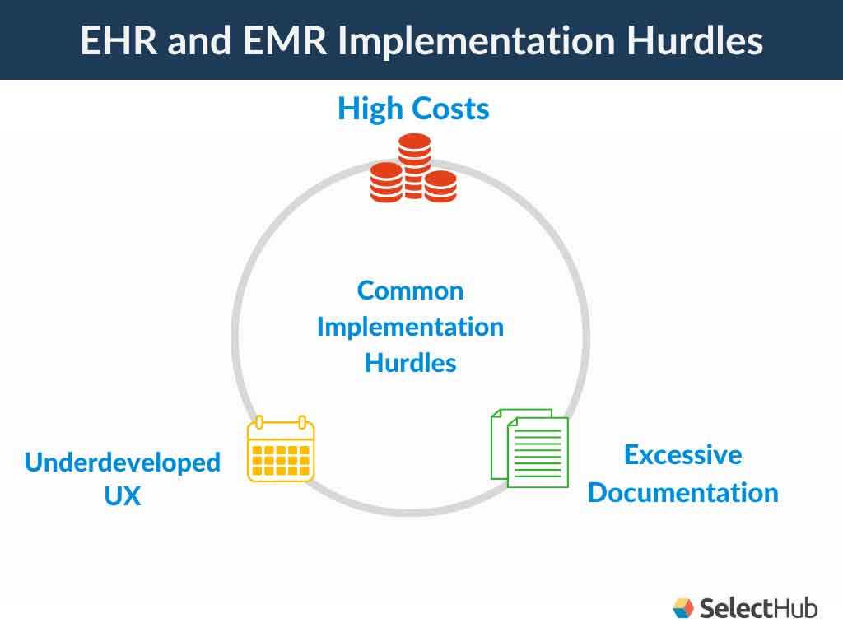

Slide 85
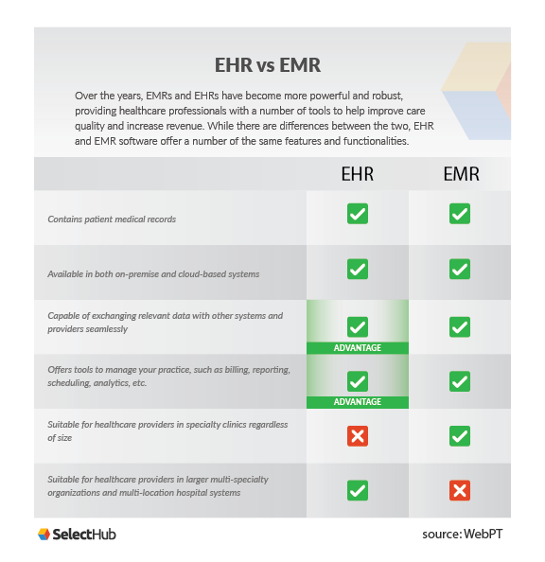

Slide 86


Slide 87

Top Technology Innovations Supporting EHR Optimization
Accessibility Interoperability Searchability Ease of Use
Standardization of EHRs Patient-centric Engagement

Slide 88
Ethics of healthcare technology
Concerns about making diagnostic and treatment decisions via the technological advances of AI;
Doctors and patients prefer the personal touch;
Privacy and liability issues;
Inequity; Better virtual healthcare; Lack of transparency; Skepticism.

Slide 89




Slide 90
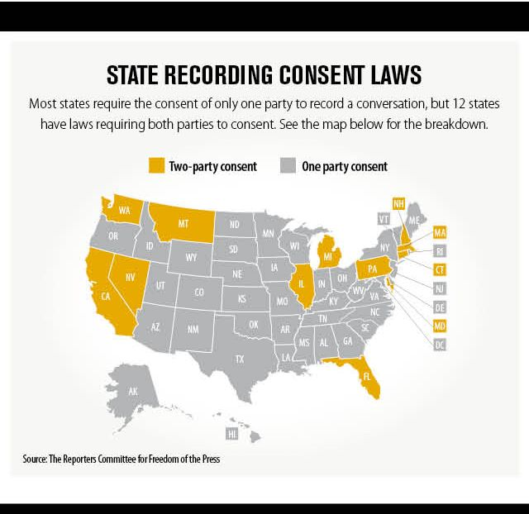


Slide 91

Body-Worn Camera

Slide 92
Telemedicine (TM)
Children with obesity and diabetes mellitus;
Teleglaucoma; Teleotolaryngology (Tele-ENT); Teleradiology; C-XR
Telehealth and AI Used to Identify Melanoma
Deep Learning, AI Improve Accuracy of Breast Cancer Detection
Teleorthopedics; Telerehabilitation; Telegastroenterology
AI Detects Medication Administration Errors
Artificial Intelligence in Alzheimer’s Disease; Teleneurosurgery;
Pediatrics; Blockchain.

Slide 93


Slide 94


November 17, 2021

Slide 95


Wearable Neuromodulation Device Launched by Teen Siblings January 07, 2022
Kamran Ansari, the company's 16-year-old CEO, and his sister, Nadia Ansari, 18

Slide 96


New cloud-based tools of Healthcare IT
New search technology of healthcare information,
  EHR generates a searchable timeline view of a patient's holistic medical records. EHR interoperability solutions.
Improved EHR documentation and creation of stronger EHR networks, such as: Scribe speech-based documentation tools, and Embedded virtual assistant

Slide 97

Grace The Humanoid Robot Healthcare Assistant
https://youtu.be/UWWttwpD-yQ

Slide 98

https://chartrequest.com/improving-patient-experience-2023/

Slide 99
Prioritize Improving the
Patient Experience
Patient Satisfaction (feel heard, respected, actively involved in their care)
Patient Loyalty (satisfied patients are more likely to become loyal)
Improved Health Outcomes (patient-centered approach that focuses on enhancing the patient experience contributes to improved health outcomes)
Enhanced Patient Engagement and Empowerment
Financial Considerations
Regulatory and Reimbursement Landscape

Slide 100
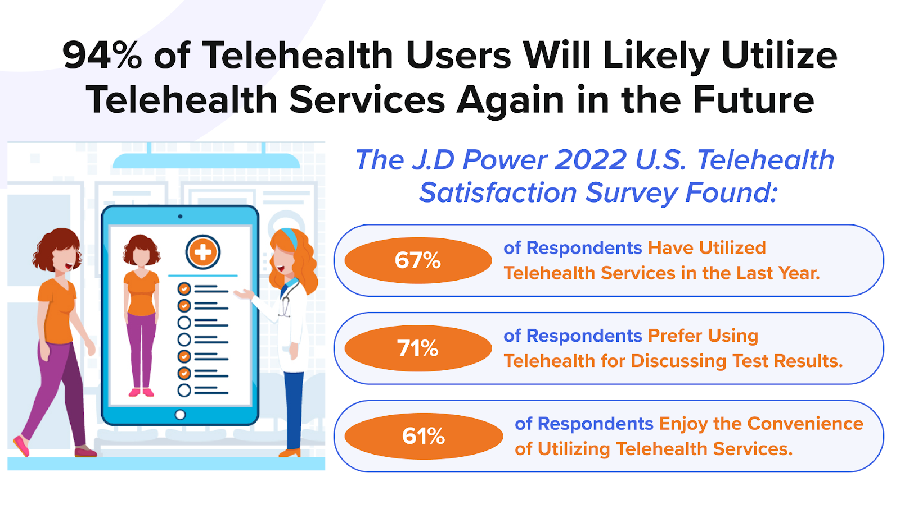
1. make patients feel care is more accessible and convenient by Embracing telehealth

Slide 101
1, make patients feel care is more accessible and convenient
Enhance Digital Patient Portals
Streamline Appointment Scheduling
Listen to Your Patients and Make Them Feel Heard
Offer Patients Personalized Communication
Embrace Patient Feedback
Prevent Patient Care Coordination Homework
Utilize AI and Data Analytics
Improve Discharge Planning
Create a Comfortable Environment for All Patients
Emphasize Empathy and Compassion
https://chartrequest.com/improving-patient-experience-2023/
Notes:
Digital patient portals serve as a gateway for patients to access necessary services and enable greater patient involvement. These may help them request medical records, communicate with providers, schedule appointments, receive test results, and more.
Patient portals make it easy for patients to find, figure out, and manage various health-related functions from organizations’ websites. For improving the patient experience, portals should be noticeable, explicitly clear and user-friendly, and designed to make relevant processes easier.

Slide 102
Q’s and A’s
Next Topic: Use of AI in Medical Records

Slide 103

LINKS:
Medical Economics July 2023
Volume: 100
Issue: 7
View Issue
Download Issue
https://www.medicaleconomics.com/journals/medical-economics/medical-economics-july-2023

Slide 104

what is AI?
Artificial intelligence refers to the development of computer systems that can perform tasks that typically require human intelligence.
https://chartrequest.com/benefits-of-ai-in-healthcare-2023/

Slide 105
Major AI Types in 2023
Administrative Applications (Apps).
Natural Language Processing (EHRs)
Machine Learning (e.g., Chatbots)
Physical Robots & Process Automation
Diagnosis and Treatment Apps
Patient Engagement/Adherence Apps
Notes:
Integrating AI into healthcare systems requires careful attention to ethical and privacy considerations.
Patient data usage must adhere to strict privacy regulations, and biases in AI algorithms need to be scrutinized and mitigated.

Slide 106


Slide 107
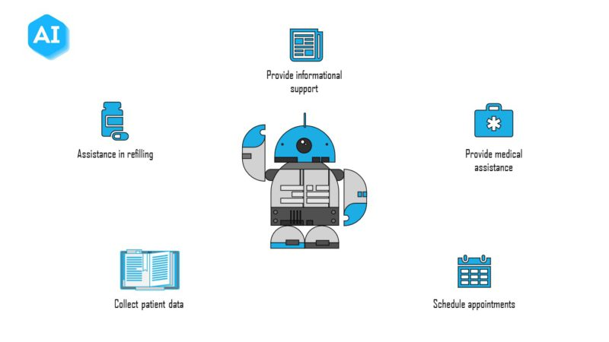

Healthcare chatbots

Slide 108

Examples of health chatbots
1. OneRemission
2. Youper
3. Babylon Health
4. Florence
5. Healthily
6. Ada Health
7. Sensely
8. Buoy Health
9. Infermedica
10 Cancer Chatbot

Slide 109

ten uses of Medical Chatbots and
AI backed health assistants

Slide 110

Some important uses of Medical chatbots
Hospital OPD
Reception systems at Clinics/Hospitals
At Home, a personal & private virtual assistant
Overcoming problems of Social stigma and taboos
Immediate medical advice in emergency situations
Preventive and lifestyle advices
Providing individualized care, specially to diabetics, hypertensives and Kidney patients
Research and Innovation benefits
Your health data managers
Providing access to health services in remote areas

Slide 111

Medical Virtual Assistant

Slide 112

Benefits of a medical virtual assistant
Save Money
No Need for Office Space
Spend More Time with Patients
Provide a Better Service
Free Up Time for Other Activities
Greater Flexibility

Slide 113

Medical Assistants
Dictation and Transcribing
Medical Assistants – Scribes nonmedical
Voice to Text – using NLP (AI)
Symptom Checkers
Virtual Medical Assistant – Remote Live
Chat Bots (Chat GPT, The PyCoach)
Google Bard’s Image Recognition
Humanoid Medical Assistants

Slide 114


Virtual assistant can handle appointment scheduling, patient registration, insurance verification, and basic triage…
Intelligent software solution, in a computer or chat bot (chatting robot), automates administrative tasks typically performed by human receptionists.
Uses artificial intelligence (AI), natural language processing (NLP), and machine learning (ML) algorithms.

Slide 115

Notes:
General Inquiry - Be it about test reports or consultation prices, our healthcare bots are readily available to guide your patients. Also, you can ask our bot for information on doctors, specialties, facilities, business hours, visiting hours, and so on.
Patient Assist – Core - This feature of our medical bot can help your visitors get appointments on a specific date with specific doctors. Our intelligent healthcare chatbots are also capable of rescheduling appointments, booking follow-up visits, providing doctor recommendations, booking regular health checkups, booking ambulances, diagnostic tests, archiving patient history, accepting payments, and symptoms capture too.
Doctor Assist - Our healthcare chatbots can assist doctors too. Whether they need help with finding the patient's medical history, preparing prescriptions, reports, getting the symptoms information as shared by the patients, or viewing daily appointment schedules – our healthcare bot covers it all!
Patient Assist - Advanced - When it comes to offering advanced patient assistance, our healthcare chatbots are ready to do so efficiently. This feature in our medical chatbot enables the bot to take orders for medicines, let patients view or download test reports, prescriptions, appointments, and even invoices. Overall, with our healthcare chatbots, you can be stress-free regarding administrative tasks!

Slide 116


Slide 117

Easy access to information related to the medical center, including list of centers, location, driving info, open hours, visitor hours and more

Slide 118

Reduce front office work load
Enable patient registration thru natural conversation.
Reduce patient wait time before consultation.

Slide 119

Enable doctor appointment booking thru casual chat with AI bots round the clock.
Avoid the unnecessary phone calls to the front desk.

Slide 120

Enable registration for diagnostic testing
View available diagnostic tests, costs etc…, and
Book appointments for diagnostic tests thru interaction with chatbots.

Slide 121

Doctor may send health updates to patients thru chatbots.
Provide information about diseases, diagnostic tests, and treatment of various medical disorders.

Slide 122
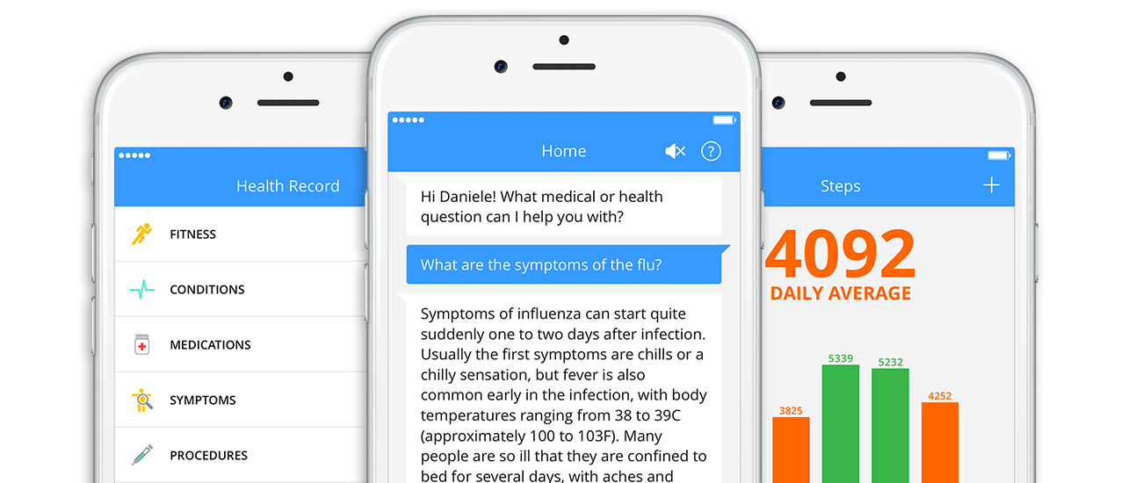
Virtual medical assistant

Slide 123




16 to 100+ Languages Instant Translator
0:49
64,129,473 views Feb 22, 2019
Talk & Translate is an essential voice and text translator that allows you to communicate anywhere in the world. Whether you are on a holiday abroad, an international business meeting, or just chatting with foreign friends, Talk & Translate will help you speak 33 languages instantly using its advanced speech recognition and translation engines.
You can now speak over 30 languages with Talk & Translate

Slide 124


