Slide 1
MEDICAL RECORD KEEPING COURSE:
Artificial Intelligence
AELM; ABLM
Joseph P. McMenamin, M.D, J.D., FCLM
McMenamin Law Offices
mcmenamin@medicalawfirm.com
© MLO 2021

Slide 2
Disclaimers: the Speaker
Speaks neither for any MLO client nor for the sponsors
Is neither a technical expert nor an IP lawyer
Offers information about the law, not legal advice
Labors under a dearth of legal authorities specific to AI
Must treat subjects in cursory fashion only
Presents theories of liability as illustrations, conceding nothing as to their validity
Criticizes no person or entity, nor AI, nor social media
Neither creates nor seeks to create an attorney-client relationship with any member of the audience
Makes no claim to copyright in clip art

Slide 3
Clinical Use Cases: Examples
Diagnosis
Mammograms for breast CA
Examining faces to screen for genetic disorders
Treatment
Insulin for diabetics
Drug development and discovery
Monitoring of infectious disease
Pneumonia cluster in Wuhan on 12/31/20

Slide 4
Agenda
AI tech 101
Research
Practicing medicine
Negligence
Product liability
Privacy
Reimbursement
Regulation
© MLO 2021

Slide 5
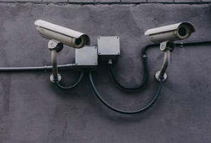
Supervised ML
Supervised: Search for patterns in data that lead to actionable insights. Commonest way to generate predictive models
Correct answer already known
Process: find model that captures relationship between a set of data "features”-their descriptive characteristics - and the "target feature"-the info the computer is to teach itself
“Supervised”: algorithm learns from the training dataset. Algorithm makes predictions iteratively on training data; “teacher” corrects
The more data available, the more effective the algorithm
Example: Have set of molecules and know which are drugs; train a model to answer whether a molecule is also a drug

Slide 6
Unsupervised ML
Unsupervised ML: no training set
We ask computer to identify structures, relationships, patterns, or trends within a data set
No “correct” answer; no “teacher”
Algorithms are left to their own devices to discover and present structure in the data
We decide whether patterns are meaningful or useful
Difficult to ascertain or explain why, for a given query, one search result ranks more highly than another
More complex, powerful algorithms usually more opaque
Example: We have molecules. Some are drugs; some are not. We do not know which are which; we want the algorithm to discover the drugs

Slide 7
Agenda
AI tech 101
Research
Practicing medicine
Negligence
Product liability
Privacy
Reimbursement
Regulation
© MLO 2021

Slide 8
Facebook’s Suicide Prevention Service: Research?
Technique is innovative, novel
Facebook taught its algorithm text to ignore
Proprietary: details not available
Informed consent?
Accuracy?
Traditional view: prediction requires analysis of hundreds of factors: race, sex, age, SES, medical history, etc.
Record of results? Publication?
Efficacy across races, sexes, nationalities?
False +: unwanted psych care?
Users: wariness enhanced?
Barnett and Torous, Ann. Int. Med. (2/12/19)

Slide 9
Agenda
AI tech 101
Research
Practicing medicine
Negligence
Product liability
Privacy
Reimbursement
Regulation
© MLO 2021

Slide 10
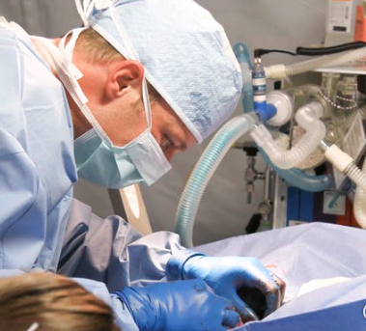
Is AI Practicing Medicine?
Facebook acquires personal info about an individual; evaluates its significance; offers advice and support; decides whether to activate the healthcare system
"’Practice of medicine…’ means the prevention, diagnosis and treatment of human physical or mental ailments, conditions, diseases, pain or infirmities by any means or method.”
Va. Code § 54.1-2900. Definitions
Licensure?
If so, in what jurisdiction(s)?
Does AI supplant or supplement the doctor’s judgment?

Slide 11
What Else Might AI Be Practicing?
”’Professional nursing’… means the performance for compensation of any nursing acts in the observation, care and counsel of individuals or groups who are ill, injured or experiencing changes in normal health processes or the maintenance of health; in the prevention of illness or disease…”
Va. Code § 54.1-3000
”’Practice of clinical psychology’ includes, but is not limited to: … ‘Diagnosis and treatment of mental and emotional disorders’ which consists of the appropriate diagnosis of mental disorders according to standards of the profession and the ordering or providing of treatments according to need.”
Va. Code § 54.1-3600

Slide 12
Agenda
AI tech 101
Research
Practicing medicine
Negligence
Product liability
Privacy
Reimbursement
Regulation
© MLO 2021

Slide 13
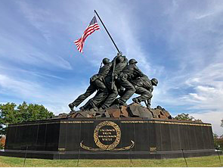
Duty
Duty arises from the doctor-patient relationship
Consulting physician who does not interact with the patient owes no duty to the patient
See Irvin v. Smith, 31 P.3d 934, 941 (Kan. 2001);
St. John v. Pope, 901 S.W.2d 420, 424 (Tex. 1995)
What if any duty has an AI system to a patient?
Does it resemble a consultant? Or an MRI, e.g.?
Epic sepsis model missed 2/3 of cases. JAMA IM 6/21
© MLO 2021

Slide 14
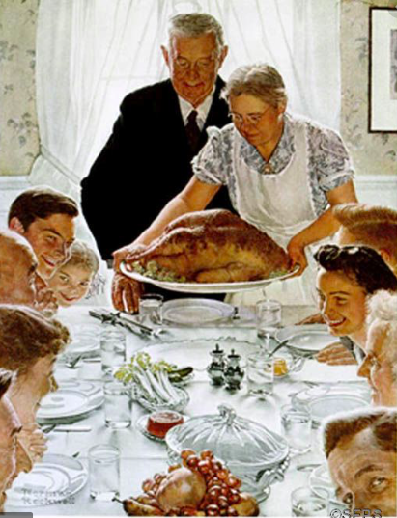
Standard of Care: Custom
What constitutes a “reasonable” AI system?
Could AI ever be anything but reasonable?
Higher SOC for a physician using AI?
Will AI endanger state standards of care?
Would reliance on AI be a defense for the MD?
Res ipsa?
Nelson v. AA, 70 Cal. Rptr. 33 (Cal. Ct. App. 1968) (auto pilot)
© MLO 2021

Slide 15
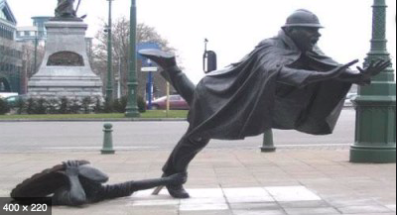
Foreseeability
Law expects actor to take reasonable steps to reduce the risk of foreseeable harms
Software developer cannot predict how unsupervised AI will solve the tasks and problems it encounters
Machine teaches itself how to solve problems in unpredictable ways
No one knows exactly what factors go into the AI system’s decisions
The unforeseeability of AI decisions is foreseeable
AI's solution may not have been foreseeable to a human -- even the human who designed the AI
Does that defeat a claim of duty?
© MLO 2021

Slide 16
Liability for Pushing AI?
Hospitals: large investments in robotic systems, e.g.
Procedures more expensive
By shifting resident teaching time from standard laparoscopy to robotic surgery, we may produce “high-cost” surgeons whom insurers will penalize
Damage to doctor-patient relationship?
The rapport problem
© MLO 2021

Slide 17
Liability for Failing to Use AI?
AI may decrease human error caused by a lack of information or experience
AI-aided diagnostic systems can weigh more factors than a physician could on his own
© MLO 2021

Slide 18
Experts
MD who had performed many robotic surgeries not qualified on causation for want of programming expertise
Mracek v. Bryn Mawr Hospital, 363 F. App'x. 925, 926 (3d Cir. 2010)(ED complicating robotic prostatectomy)
Trial court: Cardiologist not qualified to testify on weight loss drug combo that proprietary software package recommended b/c doc not a software expert
Skounakis v. Sotillo A-2403-15T2 (N.J. Super. Ct. App. Div. Mar. 19, 2018) (on appeal, reversed)

Slide 19
Agency
Is AI more like an employee or an independent contractor, or more like a machine?
Problems with agency theory:
Agent and principal must voluntarily consent to establish agency relationship
AI:
No ability to negotiate the scope of authorization
Cannot dissolve agent-principal relationship
Cannot renegotiate its terms

Slide 20
Who are the Proper Parties Defendant?*
Component designer?
Medical device company?
The owner of the AI’s algorithm?
Whoever maintains the product?
Physicians and other health care professionals?
Hospitals and health care systems?
Pharmaceutical companies?
Medical schools?
Insurers?
Regulators?
*For me: none of the above!
© MLO 2021

Slide 21
Conflicts of Interest
To what extent, if any, did pharma or a device house influence a particular algorithm?
Does a company with AI-supported suicide prevention software gain anything from deploying it?
If so, does it matter?

Slide 22
Informed Consent: Required?
Must the doctor
Be sufficiently knowledgeable to explain how AI works?
Black box problem
Assess whether the AI system was trained on a data set representative of a particular patient population?
Have information about comparative predictive accuracy and error rates of AI system across patient subgroups?
Distinguish between the roles human caregivers and the AI system will play during each part of a procedure?
Compare results with AI and human approaches?
What if there are no data?
What if the patient doesn’t want to know?
Disclose AI recommendations he disapproves, or COIs?

Slide 23
Agenda
AI tech 101
Research
Practicing medicine
Negligence
Product liability
Privacy
Reimbursement
Regulation
© MLO 2021

Slide 24
Strict Liability: Section 402A, Restatement (Second) of Torts
(1) One who sells any product in a defective condition unreasonably dangerous to the user or consumer … is subject to liability for physical harm thereby caused to the ultimate user or consumer, or to his property, if
(a) the seller is engaged in the business of selling such a product, and
(b) it is expected to and does reach the user or consumer without substantial change in the condition in which it was sold.
(2) The Rule stated in subsection (1) applies although (a) the seller has exercised all possible care in preparation and sale of his product, and (b) the user or consumer has not bought the product from or entered into any contractual relation with the seller.

Slide 25
Services v. Products
HCPs provide services, not products, so immune from products claims (transfusions, e.g.)
Algorithmic pretrial risk assessment of whether a criminal defendant should be released pending trial was not a “product” under the NJ Products Liability Act
Rodgers v. Christie, 2020 WL 1079233, at *2 (3d Cir. 2020)
The algorithm is not distributed commercially
It is not “tangible personal property nor analogous to it
Applying strict liability to the distribution of ideas: First Amendment issues
Not binding precedent
Negligence, not strict liability (liability without fault)
Courts generally treat software the same way

Slide 26
Potential Parties Defendant
Product programmer/designer
Several software developers may contribute
P might have no right to examine proprietary software
Discovery fights over software source code?
What data will Ds need to preserve?
Manufacturer putting product’s “nuts and bolts” together
The owner of the AI’s algorithm?
Whoever maintains the product?
The consumer who home-programmed the product?

Slide 27
Could a Robot/AI be Liable?
Analogies?
Corporations
In rem jurisdiction
Admiralty: A vessel can be arrested, seized, or sold, e.g.
Eur. Parliament Comm. on Legal Affairs, Rep. with Recommendations to the Comm'n on Civil Law Rules on Robotics, Parl. Eur. Doc. 582.443v03-00 (2017)(registering “electronic persons;” EU Agency for Robotics; civil liability for damages they cause)(tabled)

Slide 28
Agenda
AI tech 101
Research
Practicing medicine
Negligence
Product liability
Privacy
Reimbursement
Regulation
© MLO 2021

Slide 29
Privacy
Big data
Amazon’s Alexa and the NHS: no ? sharing of pt data
Duration of retention of information?
Facebook, again: No opt-in or opt-out
Targeted ads?
HIPAA: N/A. No covered entity, no business associate
Is de-identification obsolete?
COPPA: N/A: child committing suicide was >13 yo
Va. Consumer Data Protection Act
No private right of action
Excludes businesses subject to HIPAA
But HIPAA often N/A AI in healthcare

Slide 30
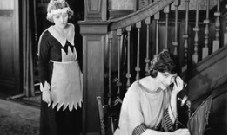
Privacy: 3d Party Doctrine
3d Party Doctrine: “a person has no legitimate expectation of privacy in information he voluntarily turns over to third parties."
Smith v. Maryland, 442 U.S. 735 (1979)(pen register); United States v. Miller, 425 U.S. 435 (1976)
Questioned: United States v. Jones, 565 U.S. 400, 417 (2012) (Sotomayor, J., concurring)
Application to social media?
Bank records, credit card statements, etc.
Application to, e.g., digital assistants?
Alexa?

Slide 31
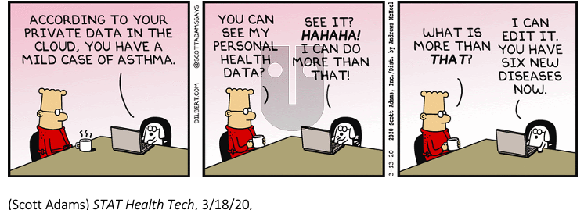

Slide 32
Agenda
AI tech 101
Research
Practicing medicine
Negligence
Product liability
Privacy
Reimbursement
Regulation
© MLO 2021

Slide 33
Reimbursement
Provided for "medically necessary" care
Not: experimental treatments or devices
Slow governmental adoption: the telehealth model
CMS, 2018:
”…unnecessary gaps between FDA approval of a technology and Medicare paying for the technology.”
“[C]overage decisions will be more transparent and more responsive to innovators bringing new medical technologies to our Medicare beneficiaries”
© MLO 2021
Notes:
See generally Medicare Coverage Determination Process, CMS.GOV (Mar. 6, 2018), https://www.cms.gov/Medicare/Coverage/DeterminationProcess/index.html.
Seema Verma, Modernizing Medicare to Take Advantage of the Latest Technologies, CMS BLOG (Oct. 2 2018), https://www.cms.gov/blog/modernizing-medicare-take-advantage-latest-technologies.

Slide 34
Reimbursement
Artificial Intelligence (AI) Health Outcomes Challenge
Demonstrate how AI can predict unplanned hospital and SNF admissions and adverse events
COVID pause
AI to review coding decisions: train to maximize reimbursable services not originally coded for billing
Recovery Audit Contractors use AI-powered algorithms to ID erroneous and/or fraudulent submissions
Should patients get paid for their data?
© MLO 2021
Notes:
Recovery Audit Contractors

Slide 35
Reimbursement
9/20: CMS approved the 1st add-on payment - up to $1,040, + inpatient hospitalization costs -for use of software to help detect strokes by Viz.ai.
Whether a 43-patient study used to support the company’s claim of clinical benefit was large enough to warrant the added reimbursement?
Concern with AI: will suffer same fate as computer-aided detection software, which increased the costs of screening mammograms by hundreds of millions of dollars in the U.S. yet failed to improve outcomes

Slide 36
Manipulation to Enhance Reimbursement?
MDs, hospitals, others could manipulate the AI in billing or insurance software to maximize payments
Ambiguity in medical information
Competing financial incentives
Alter images?
Changing a few pixels could make skin lesion seem malignant
Or: rotating the image
Alcohol abuse” v. “alcohol dependence;” “lumbago” v. “back pain”
Insurers, health care agencies: reverse
© MLO 2021

Slide 37
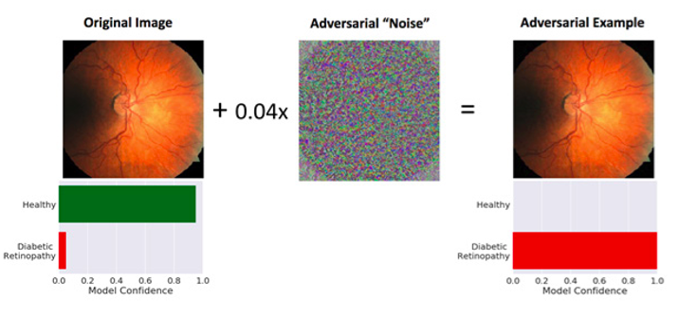

Slide 38
Agenda
AI tech 101
Research
Practicing medicine
Negligence
Product liability
Privacy
Reimbursement
Regulation
© MLO 2021

Slide 39
Regulation: FDA
Regulatory intensity ∝ risk
Software for dx or tx: higher risk than SW that “drives” or “informs” management
Key: intended use
Are black box algorithms “medical devices”?
If not, are they LDTs? CDS software, e.g.
Diagnosis and treatment: higher risk than either alone?
Devices w/new intended uses: Class III as a matter of law
Time for “competent human intervention”?
21st Century Cures Act: removed some software types from FDA authority, including some CDS software
© MLO 2021

Slide 40
21st Century Cures Act: CDS Exempt if
1. It displays, analyzes, or prints medical info
About a patient or
Other medical info: clinical studies, CPGs; or
2. It supports or provides recommendations to HCPs “about prevention, diagnosis, or treatment of a disease or condition” while “enabling such HCPs to independently review the basis for such recommendations…so that it is not the intent that such HCP rely primarily on any of such recommendations to make a clinical diagnosis or treatment decisions regarding an individual patient.”
© MLO 2021

Slide 41
FDA Regulation
Accommodating tech:
“Pre-Cert” program: for companies with “culture of quality” and “organizational excellence”
Post-market data collection
De Novo premarket review pathway: no predicate device, but low to moderate risk
Challenging the Agency:
Is FDA regulating the practice of medicine?
Could medical algorithms be commercial speech?
If FDA does regulate, are state claims preempted?
What if design is constantly changing due to AI/ML?
Biden administration, 4/16: reverses Trump’s 1/21 call to lift review requirements for certain AI
© MLO 2021

Slide 42
FDA Approval of AI- and ML-Enabled Devices, by year

Slide 43
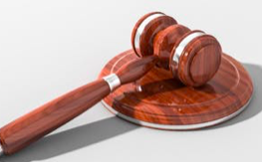
Other AI Issues
IP: patents
Thaler v. Iancu, [No. 1:2020cv00903 - Document 33 (E.D. Va. 2021)]: AI cannot hold a patent (“individual”)
Australia, South Africa: opposite conclusion
Bias: dx melanomas in light v. dark skin, e.g.
Social science subjects: western, educated, industrialized, rich, and democratic (“WEIRD”)
Corporate practice of medicine
Ownership of data
Antitrust
Algorithmic pricing can be highly competitive
But competitors could use the same software to collude
Unemployment: recursive self-improvement

Slide 44
Questions? Comments?
Joseph P. (“Joe”) McMenamin
McMenamin Law Offices, PLLC
mcmenamin@medicalawfirm.com
804.921.4856

Slide 45
References
Jessica S. Allain, “From Jeopardy! to Jaundice: The Medical Liability Implications of Dr. Watson and Other Artificial Intelligence Systems,” 73 La. L. Rev. 1049, 1061, 1062 (2013)
Julia Angwin et al., “Machine Bias,” ProPublica (May 23, 2016), https://www.propublica.org/article/machine-bias-risk-assessments-in-criminal-sentencing
Emily Berman, “A Government of Laws and Not of Machines,” 98 B.U.L. Rev. 1278, 1315, 1316 (2018)
Jenna Burrell, “How the Machine ‘Thinks': Understanding Opacity in Machine Learning Algorithms,” Big Data & Soc'y, Jan.-June 2016
Karni Chagal-Feferkorn, “The Reasonable Algorithm,” U. Ill. J.L. Tech. & Pol'y (forthcoming 2018)

Slide 46
References, 2
Niteesh K. Choudhry, Henry Thomas Stelfox & Allan S. Detsky, “Relationships Between Authors of Clinical Practice Guidelines and the Pharmaceutical Industry,” 287 JAMA 612 (2002)
Duke Margolis Center for Health Policy, “Current State and Near-Term Priorities for AI-Enabled Diagnostic Support Software in Health Care” (2019)
Henry T. Greely, “Neuroscience, Artificial Intelligence, CRISPR - and Dogs and Cats,” 51 U.C. Davis L. Rev. 2303 (2018)
© MLO 2021

Slide 47
References, 3
Michael Guihot, Anne F. Matthew & Nicolas P. Suzo, “Nudging Robots: Innovative Solutions to Regulate Artificial Intelligence,” 20 Vand. J. Ent. & Tech. L. 385, 410, 411 (2017)
Korenman, S.G., Teaching the Responsible conduct of Research in humans (RCRH) Common Rule, Office of Research Integrity, DHHS
Cade Metz and Craig S. Smith, “Warnings of a Dark Side to A.I. in Health Care,” NY Times (3/21/19)
© MLO 2021

Slide 48
References, 4
Roger Michalski, “How to Sue a Robot,” 18 Utah L. Rev. 1022, 1042 (2018)
National Artificial Intelligence Research Resource Task Force
Ziad Obermeyer and Ezekiel J. Emanuel, “Predicting the Future – Big Data, Machine Learning, and Clinical Medicine,” N. Engl. J. Med. (Sep. 29, 2016)
W. Nicholson Price II, “Regulating Black-Box Medicine,” 116 Mich. L. Rev. 421, 429, 430 (2017)
© MLO 2021

Slide 49
References, 5
Daniel Schiff and Jason Borenstein, “How Should Clinicians Communicate With Patients About the Roles of Artificially Intelligent Team Members?” 21(2) AMA Journal of Ethics E138-145 (Feb. 2019)
Amanda Swanson and Fazal Khan, “The Legal Challenge of Incorporating Artificial Intelligence into Medical Practice,” 6(1) J. Health & Life Sci. L. 90 (2012)
Matthew U. Scherer, “Regulating Artificial intelligence Systems: Risks, Challenges, Competencies, and Strategies,” 29 Harv. J.L. & Tech. 353 (2016)
© MLO 2021

Slide 50
References, 6
Nicolas P. Terry, “Appification, AI, and Healthcare's New Iron Triangle,” [Automation, Value, and Empathy] 20 J. Health Care L. & Pol'y 118 (2018)
Wendell Wallach, A Dangerous Master 239-43 (2015). Andrew Tutt, “An FDA for Algorithms,” 69 Admin. L. Rev. 83, 104 (2018)

